Slide 9
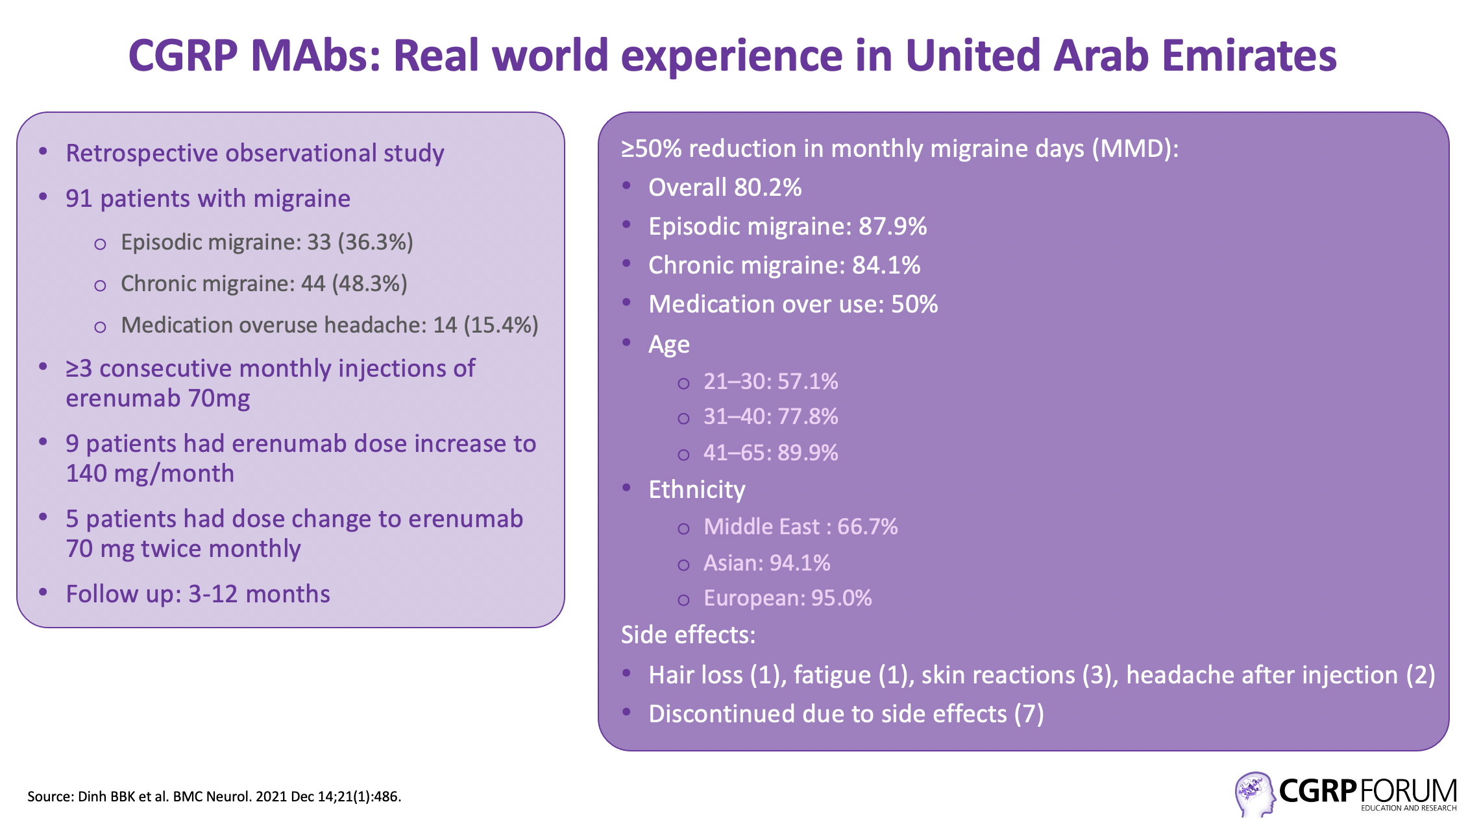

Slide 10
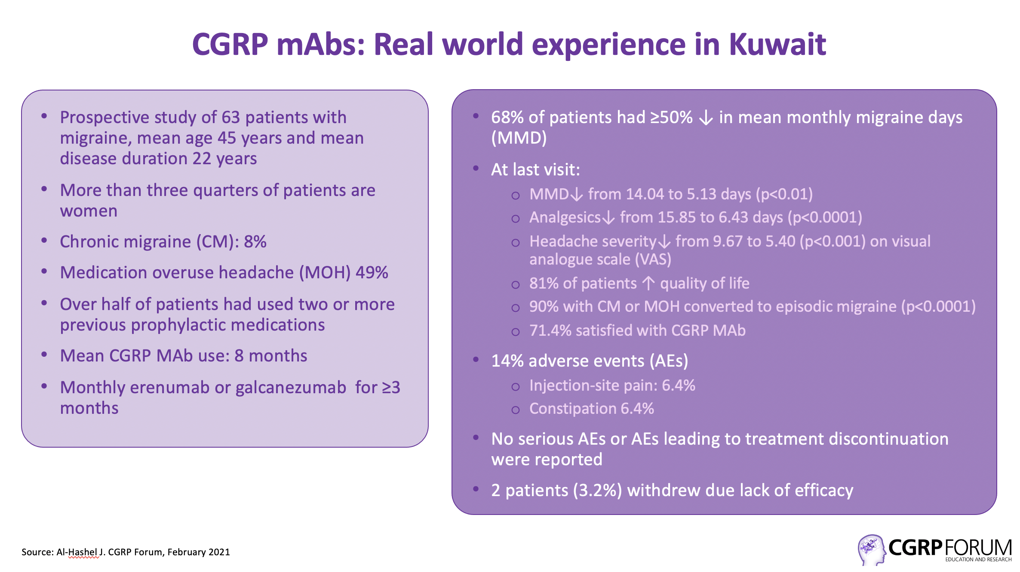

Slide 11
References (1)
Epidemiology
Atif M, Hussain S, Sarwar M, Saqib A. A review indicating the migraine headache as a prevalent neurological disorder: Still under-estimated, under-recognized, under-diagnosed and under-treated. Journal of Pharmacy Practice and Community Medicine 2017; 3(1): 03-11.
El-Sherbiny NA, Masoud M, Shalaby NM et al. Prevalence of primary headache disorders in Fayoum Governorate, Egypt. The Journal of Headache and Pain 2015; 16: 85.
Erenumab
Goadsby PJ, Reuter U, Hallström Y et al. A controlled trial of erenumab in episodic migraine. N Engl J Med. 2017 Nov 30;377(22):2123-2132.
Tepper S, Ashina M, Reuter U et al. Safety and efficacy of erenumab for preventive treatment of chronic migraine: a randomised, double-blind, placebo-controlled phase 2 trial. Lancet Neurol. 2017 Jun;16(6):425-434.
Reuter U, Goadsby PJ, Lanteri-Minet M et al. Efficacy and tolerability of erenumab in patients with episodic migraine in whom two-to-four previous preventive treatments were unsuccessful: a randomised, double-blind, placebo-controlled, phase 3b study. Lancet. 2018 Nov 24;392(10161):2280-2287.
Wang SJ, Roxas AA Jr, Saravia B et al. Randomised, controlled trial of erenumab for the prevention of episodic migraine in patients from Asia, the Middle East, and Latin America: The EMPOwER study. Cephalalgia. 2021 Nov;41(13):1285-1297.
Reuter U, Ehrlich M, Gendolla A et al. Erenumab versus topiramate for the prevention of migraine – a randomised, double-blind, active-controlled phase 4 trial. Cephalalgia 2021 Nov 7. Online ahead of print.
Fremanezumab
Dodick DW, Silberstein SD, Bigal ME, et al. Effect of fremanezumab compared with placebo for prevention of episodic migraine: a randomized clinical trial. JAMA 2018; 319:1999–2008.
Silberstein SD, Dodick DW, Bigal ME, et al. Fremanezumab for the preventive treatment of chronic migraine. N Engl J Med 2017;377:2113–2122.
Ferrari MD, Diener HC, Ning X et al. Fremanezumab versus placebo for migraine prevention in patients with documented failure to up to four migraine preventive medication classes (FOCUS): a randomised, double-blind, placebo-controlled, phase 3b trial. Lancet. 2019 Sep 21;394(10203):1030-1040.
Goadsby PJ, Silberstein SD, Yeung PP et al. Long-term safety, tolerability, and efficacy of fremanezumab in migraine: A randomized study. Neurology 2020 Nov 3;95(18):e2487-e2499.

Slide 12
References (2)
Galcanezumab
Stauffer VL, Dodick DW, Zhang Q et al. Evaluation of Galcanezumab for the Prevention of Episodic Migraine: The EVOLVE-1 Randomized Clinical Trial. JAMA Neurol. 2018 Sep 1;75(9):1080-1088.
Detke HC, Goadsby PJ, Wang S, Friedman DI et al. Galcanezumab in chronic migraine: The randomized, double-blind, placebo-controlled REGAIN study. Neurology. 2018 Dec 11;91(24):e2211-e222.
Mulleners WM, Kim BK, Láinez MJA et al. Safety and efficacy of galcanezumab in patients for whom previous migraine preventive medication from two to four categories had failed (CONQUER): a multicentre, randomised, double-blind, placebo-controlled, phase 3b trial. Lancet Neurol. 2020 Oct;19(10):814-825.
Goadsby PJ, Dodick DW, Leone M et al. Trial of Galcanezumab in Prevention of Episodic Cluster Headache. N Engl J Med. 2019 Jul 11;381(2):132-141.
Eptinezumab
Ashina M, Saper J, Cady R et al. Eptinezumab in episodic migraine: A randomized, double-blind, placebo-controlled study (PROMISE-1). Cephalalgia. 2020 Mar;40(3):241-254.
Lipton RB, Goadsby PJ, Smith J et al. Efficacy and safety of eptinezumab in patients with chronic migraine: PROMISE-2. Neurology. 2020 Mar 31;94(13):e1365-e1377.
Kudrow D, Cady RK, Allan B et al. Long-term safety and tolerability of eptinezumab in patients with chronic migraine: a 2-year, open-label, phase 3 trial. BMC Neurology 2021; 21: 126.
Winner PK, McAllister P, Chakhava G et al. Effects of intravenous eptinezumab vs placebo on headache pain and most bothersome symptom when initiated during a migraine attack. JAMA 2021; 325 (23): 2348-2356.
Rimegepant
Lipton RS, Croop R, Stock EG et al. Rimegepant, an oral calcitonin gene-related peptide receptor antagonist, for migraine. N Engl J Med 2019; 381: 142-149.
Croop R, Goadsby PJ, Stock DA et al. Efficacy, safety and tolerability of rimegepant orally disintegrating table for the acute treatment of migraine: a randomised, phase 3, double-blind, placebo-controlled trial. Lancet 2019; 394: 737-745.
Croop R, Lipton RB, Kudrow K et al. Oral rimegepant for preventive treatment of migraine: a phase 2/3, randomised, double-blind, placebo-controlled trial. Lancet 2021; 397:51-60
Vydura (rimegepant). Summary of Product Characteristics, May 2022.
Real World
Dinh BBK, Aziz WH, Rerruzzi A, Krieger DW. Initial experience with novel CGRP-receptor inhibitor therapy in Migraine in the United Arab Emirates: a retrospective observational study. BMC Neurol. 2021 Dec 14;21(1):486.
Al-Hashel J. How are patients responding to CGRP monoclonal antibodies in Kuwait? CGRP Forum.

