Slide 1


A Background
CGRP THERAPEUTIC MONOCLONAL ANTIBODIES

Slide 2
MIGRAINE AND CGRP

Slide 3
About migraine
Migraine is a common neurological disorder
Current thinking is that migraine is a complex condition which is thought to involve the vasculature, central and peripheral neuronal pathways involved in pain signalling, as well as inflammation
While the events that actually initiate a migraine attack remain unknown, activation of the trigeminovascular system is considered key
In the search for chemical mediators of migraine, accumulating evidence supports a role for Calcitonin Gene-Related Peptide (CGRP)
Amara SG et al. Nature 1982;298:240
Notes:
What is migraine?
Migraine is a complex condition involving the vasculature, central and peripheral neuronal pathways involved in pain signalling, as well as inflammation. Activation of the trigeminovascular
system is thought to play a key role.
References
Russell FA et al. Calcitonin Gene-Related Peptide: physiology and pathophysiology. Physiol Rev 2013;94:1099.

Slide 4
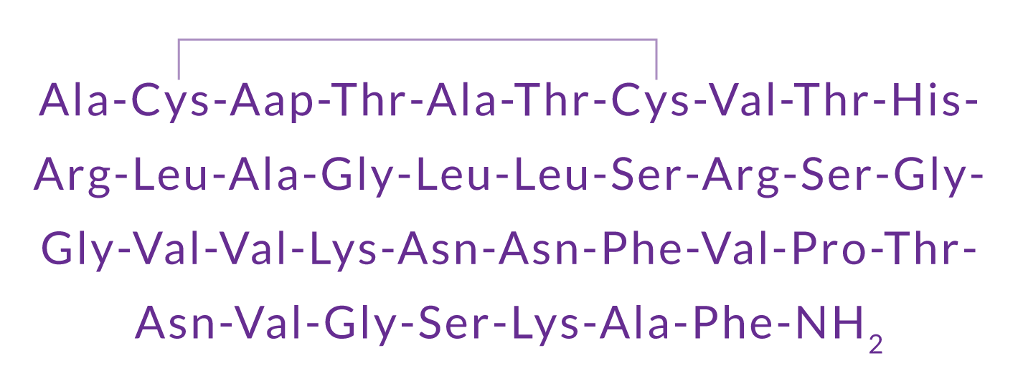


What is Calcitonin Gene-Related Peptide (CGRP)?
CGRP is a 37-amino acid neuropeptide derived from the gene encoding calcitonin. It functions as a messenger in nerve cells and as a vasodilator.
CGRP exists in two forms in humans: the α form predominates
CGRP is found in the peripheral and central nervous systems. This is formed from the alternative splicing of the calcitonin/CGRP gene located on chromosome 11.
CGRP is found in the enteric nervous system. This differs in 3 amino acids.
Amara SG et al. Nature 1982;298:240
Notes:
What is Calcitonin Gene-Related Peptide (CGRP)?
CGRP is a 37 amino acid neuropeptide, derived from the gene encoding calcitonin. It exists as two isoforms; α-CGRP in the peripheral and central nervous systems and β-CGRP mainly in the enteric nervous system. The α form predominates.
In the periphery, CGRP mediates vasodilatation whereas centrally, it mediates the transmission of pain and is also involved in regulatory mechanisms (the latter in the brainstem).
CGRP belongs to the calcitonin family of peptides that also includes adrenomedullin, calcitonin, and
amylin, all of which have important physiologic functions.
References
Russell FA et al. Calcitonin Gene-Related Peptide: physiology and pathophysiology. Physiol Rev 2013;94:1099.

Slide 5
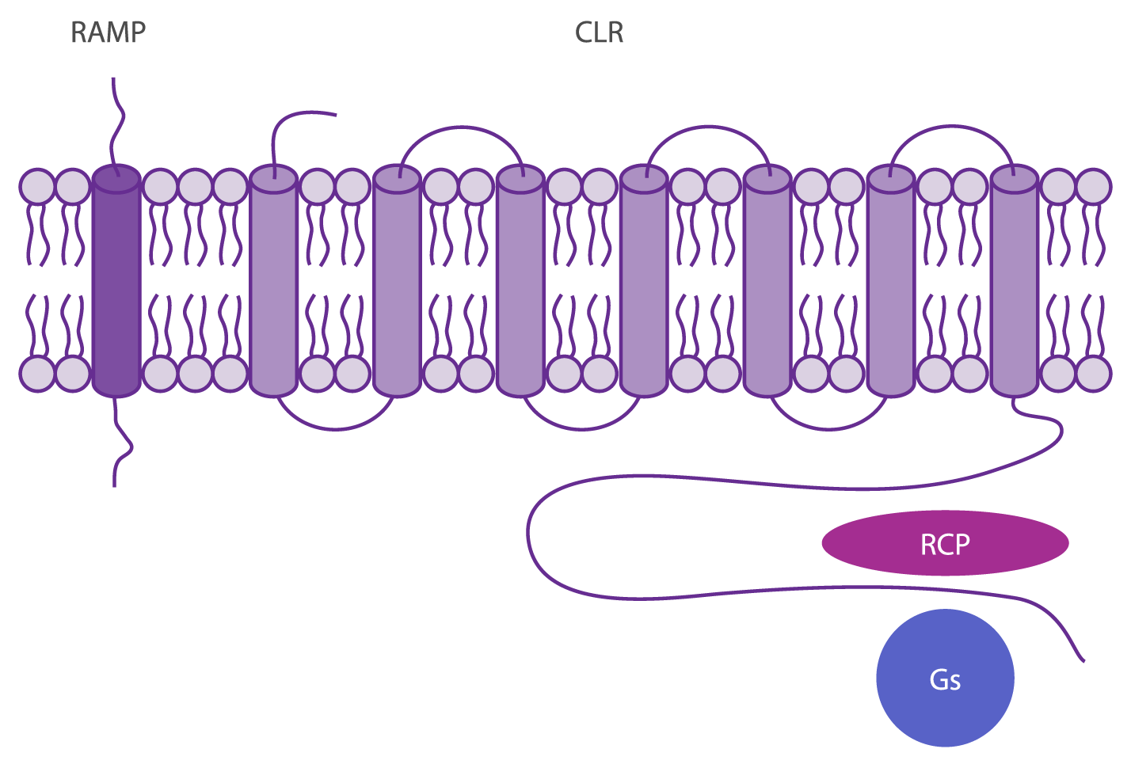
Where does CGRP bind?
CGRP binds to CGRP receptors, which are found throughout the body.
The CGRP receptor is a heterotrimer. It is composed of calcitonin-like receptor (CLR), a 7 transmembrane Gs protein-coupled structure, and the receptor activity-modifying protein (RAMP1).
The receptor component protein (RCP) is important for signaling.
Karsan N, Goadsby PJ. Curr Neurol Neurosci Rep 2015 15: 25.
Notes:
Where does CGRP bind?
Extracellular CGRP binds with high affinity to the CGRP receptor, which is a heterotrimer, i.e. derived from two or more different (but similar) monomers. Specifically, the CGRP receptor complex consists of the calcitonin-like receptor (CLR), a 7 transmembrane Gs protein coupled structure, and the receptor activity-modifying protein (RAMP1). A small intracellular protein component, called receptor component protein (RCP), links the receptor to the intracellular signalling pathway.
Reference
Karsan N, Goadsby PJ. CGRP Mechanism Antagonists and Migraine Management. Curr Neurol Neurosci Rep 2015;15:25.

Slide 6
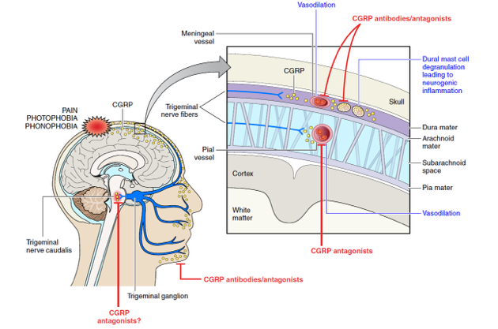
CGRP plays a pivotal role in migraine
Russell FA et al. Physiol Rev 2014;94:1099.
Notes:
CGRP plays a pivotal role in migraine
Pain during a migraine attack is linked to the release of CGRP. Studies show that CGRP levels increase during an acute migraine, and decrease during effective treatment of an attack. Additionally, infusion of CGRP has been shown to trigger a migraine in migraine sufferers.
Taken together, these lines of evidence support a role for CGRP in migraine neurobiology, and thus as a potential therapeutic target.
References
Goadsby PJ et al. Vasoactive peptide release in the extracerebral circulation of humans during migraine headache. Ann Neurol 1990;28:183.
Hansen JM et al. Calcitonin gene-related peptide triggers migraine-like attacks in patients with migraine with aura. Cephalalgia 2010;30,1179.
Russell FA et al. Calcitonin Gene-Related Peptide: physiology and pathophysiology. Physiol Rev 2013;94:1099.

Slide 7
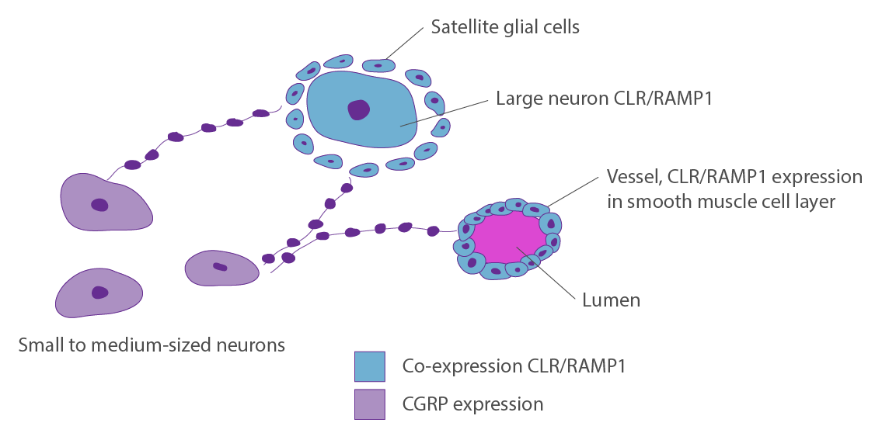
Do CGRP-targeted agents need to cross the blood-brain barrier?
The trigeminal ganglion is a key site of action for CGRP in migraine
CGRP and CGRP receptors are expressed in the trigeminal ganglion. As the trigeminal ganglion is expressed outside the blood-brain barrier (BBB), therapeutic agents do not need to penetrate the BBB to act.
Eftekhari S et al. Brain Res 2015; 1600:93.
Notes:
The trigeminal ganglion has been identified as a key site of action for CGRP in migraine. This poses a key question: where is this located with respect to the blood brain barrier? Administration of Evans Blue (a dye which binds to serum albumin and cannot therefore cross the blood brain barrier), in rats showed that the dye was taken up by the trigeminal ganglion. This shows that the trigeminal ganglion is located outside the blood brain barrier, and that it is therefore not necessary for agents targeting CGRP to cross the blood brain barrier.
Reference
Eftekhari S et al. Localization of CGRP, CGRP receptor, PACAP and glutamate in trigeminal ganglion. Relation to the blood-brain barrier. Brain Res 2015; 1600:93.
Do CGRP-targeted agents need to cross the blood brain barrier?

Slide 8
Are CGRP receptor antagonists an effective approach?
A number of small-molecule CGRP receptor antagonists were shown to be effective in (acute) treatment of migraine
However, there were a number of issues, including liver toxicity with some agents
Other approaches are needed
Ddiener HC- et al. Lancet Neurol 2015;14:1010.
Notes:
Are CGRP receptor antagonists an effective approach?
In a proof of concept study, the CGRP receptor antagonist olcegepant was shown to be effective in treating migraine. However, as this agent could only be administered intravenously, development was terminated. Other CGRP receptor antagonists were effective in acute migraine but had issues with liver toxicity (telcagepant, MK-3207); development has not continued for undisclosed reasons with other agents (rimegepant, BI 44370 TA, MK-1602). There is no ongoing development of other CGRP-receptor antagonists.
References
Doods H, Hallermayer G, Wu D, et al. Pharmacological profile of BIBN4096BS, the first selective small molecule CGRP antagonist. Br J Pharmacol 2000;129:420.
Ho TW, Connor KM, Zhang Y, et al. Randomized controlled trial of the CGRP receptor antagonist telcagepant for migraine prevention. Neurology 2014;83:958.
Hewitt DJ, Aurora SK, Dodick DW, et al. Randomized controlled trial of the CGRP receptor antagonist MK-3207 in the acute treatment of migraine. Cephalalgia 2011;31:712.
Diener HC, Barbanti P, Dahlöf C et al. BI 44370 TA, an oral CGRP antagonist for the treatment of acute migraine attacks: results from a phase II study. Cephalalgia 2011;31:573.
Peroutka SJ. Clinical trials update. 2013: year in review. Headache 2014;54:189.

Slide 9
CGRP ANTIBODIES: AN OVERVIEW

Slide 10
Targeting CGRP or the CGRP receptor?
Therapeutic monoclonal antibodies have been developed that inhibit the activity of CGRP at the CGRP receptor. However, the cross-talk inhibition is different.
Monoclonal antibodies to the CGRP receptor only inhibit function at the CGRP receptor, leaving other calcitonin-family receptors functionally intact. To date, there is only one monoclonal antibody therapeutic (erenumab, AMG 334) that targets the CGRP receptor
Monoclonal antibodies to the CGRP ligand inhibit the function of CGRP at all calcitonin-family receptors. To date, there are 3 monoclonal antibodies to the CGRP ligand in development: ALD403, galcanezumab (LY2951742), and TEV-48125

Slide 11
Summary of development of CGRP therapeutic monoclonal antibodies
 | Erenumab (AMG 334) | ALD403 | Galcanezumab LY2951742 | TEV-48125
Target | CGRP receptor | CGRP | CGRP | CGRP
Migraine types studied | Episodic Chronic | Episodic Chronic | Episodic Chronic Cluster headache | Episodic Chronic
Route of administration | SC (monthly) | IV | SC (2-weekly or monthly) | SC (monthly)
Half-life (days) | 21 | 31 | 28 | 45
Current development phase | Phase 3 (both) | Phase 3 (Episodic Migraine) Phase 2 (Chronic Migraine) | Phase 3 | Phase 3

Slide 12
Erenumab (AMG 334):
A CGRP receptor monoclonal antibody

Slide 13
Erenumab (AMG 334) for prevention of episodic migraine: Study design
Randomized, double-blind, phase 2 trial in 483 patients with episodic migraine in North America and Europe
Episodic migraine defined as 4-14 migraine days per month.
Randomization (2:2:2:3) to AMG 334 7mg, 21mg, or 70mg SC or placebo SC once monthly for 12 weeks
No oral preventive therapy was allowed during or 2 months before study (6 months for onabotulinumtoxinA)
Exclusions: >3 days/month of opioid or butalbital use; failed ≥2 preventive medications; simple analgesics ≥15 days/month or triptans ≥10 days per month
Primary endpoint: change from baseline in migraine days (migraine or probable migraine >30 mins, or any duration if used migraine-specific drug) during the last 4 weeks of treatment (weeks 9–12)
Secondary endpoint: 50% responder rates; change in monthly migraine attacks
Sun H et al. Lancet Neurol 2016;15:382.
Notes:
Erenumab (AMG 334) for prevention of episodic migraine: Study design
This was a multicentre, randomised, double-blind, placebo-controlled trial in 483 patients (mean age 39.9-42.6 years, 77-83% women, with a mean disease duration of 20 years). Patients were randomized to either AMG 334 7mg, 21mg or 70mg or placebo for 12 weeks.
Episodic migraine was defined as 4-14 migraine days/month and <15 headache days/month (≥50% of headache days being migraine days) in each of the 3 months before screening.
The primary endpoint was the change in monthly migraine days from baseline to week 12 (number of migraine days during weeks 9-12 – number of migraine days during 4 weeks at baseline). A migraine day was defined as any day on which the patient had an onset, continuation or recurrence of a migraine (i.e. migraine headache with or without aura lasting for at least 30 minutes and either two pain features [unilateral, throbbing, moderate to severe, or associated with exercise or physical activity] or at least one associated non-pain feature [nausea, vomiting, or both photophobia and phonophobia]).
The pre-specified secondary endpoints were 1) the proportion of patients with at least 50% reduction from baseline in monthly migraine days (50% responder rate) at week 12; and 2) change in monthly migraine attacks from baseline at week 12.
Reference
Sun H et al. Safety and efficacy of AMG 334 for prevention of episodic migraine: a randomised, double-blind, placebo-controlled, phase 2 trial. Lancet Neurol 2016; 15:382.

Slide 14
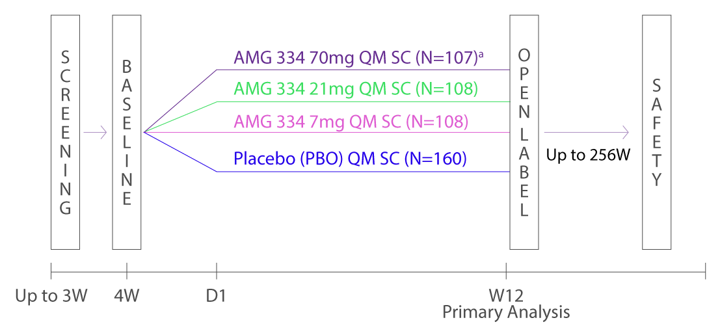
Erenumab (AMG 334) for prevention of episodic migraine: Study design
Sun H et al. Lancet Neurol 2016;15:382.
Notes:
Erenumab (AMG 334) for prevention of episodic migraine
The study design is summarised in the slide. The study comprised 4 phases:
Screening (up to 3 weeks)
Baseline screening (up of 4 weeks)
Double-blind treatment (12 weeks)
Open-label extended follow-up (up to 256 weeks). There was a safety follow-up 12 weeks after the last dose of study treatment.
Reference
Sun H et al. Safety and efficacy of AMG 334 for prevention of episodic migraine: a randomised, double-blind, placebo-controlled, phase 2 trial. Lancet Neurol 2016; 15:382.

Slide 15
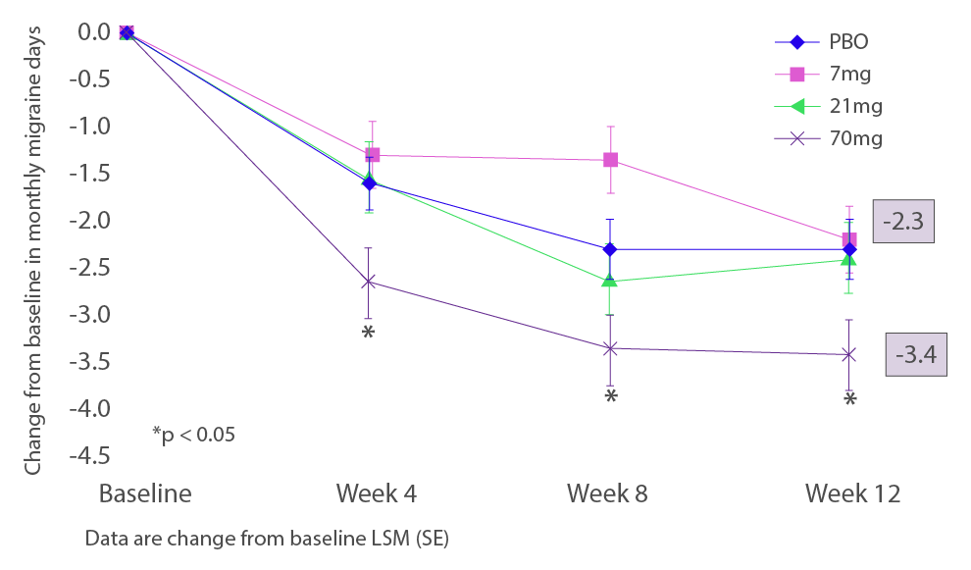
Erenumab (AMG 334) for prevention of episodic migraine:
Primary endpoint analysis
Sun H et al. Lancet Neurol 2016;15:382.
Notes:
Erenumab (AMG 334) for prevention of episodic migraine: Primary endpoint analysis
The primary endpoint was the change in monthly migraine days from baseline to the last 4 weeks (weeks 9-12) of double-blind treatment.
Treatment with AMG 334 70mg significantly reduced the primary endpoint compared with placebo (least squares mean change [standard error] -3.4 [0.4] days versus -2.3 [0.3] days; difference -1.1 days, 95% CI -2.1 to -0.2, p=0.021). The primary endpoint with AMG 334 7mg (-2.2 [0.4] days) and AMG 334 21mg (-2.4 [0.4] days) did not differ significantly from placebo.
Reference
Sun H et al. Safety and efficacy of AMG 334 for prevention of episodic migraine: a randomised, double-blind, placebo-controlled, phase 2 trial. Lancet Neurol 2016; 15:382.

Slide 16
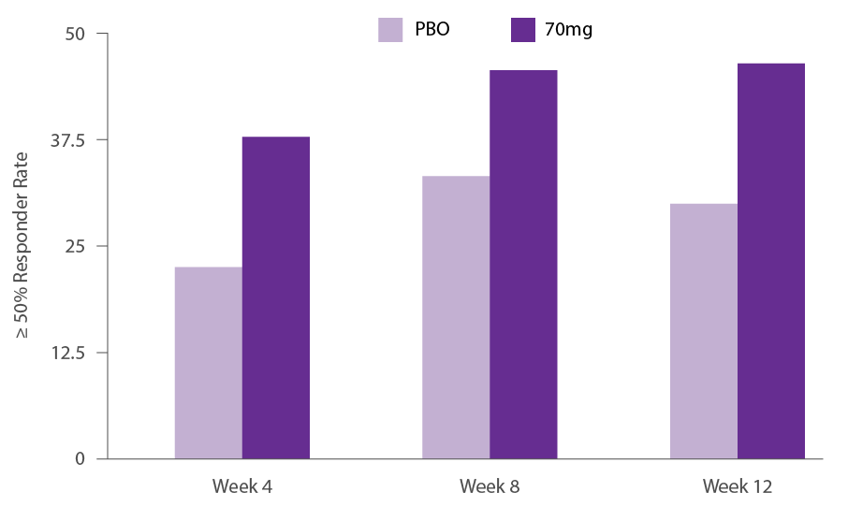
Erenumab (AMG 344) for prevention of episodic migraine: 50% responder rates
* p=0.011
The 50% responder rate at Week 12 was significantly greater with AMG 334 70mg than placebo (46% versus 30%, p=0.011)
There were no significant differences between placebo and AMG 334 7mg or AMG 334 21mg
Sun H et al. Lancet Neurol 2016;15:382.
Notes:
Erenumab (AMG 334) for prevention of episodic migraine: 50% responder rates
A key pre-specified secondary endpoint was the proportion of patients with at least 50% reduction from baseline in monthly migraine days (50% responder rate) at week 12.
This endpoint was significantly greater with AMG 334 70mg than placebo at week 12: 46% (46/99) versus 30% (43/144), odds ratio 2.0, 95% CI 1.2 to 3.4, p=0.011). The 50% responder rate with AMG 334 70 mg was also greater than placebo at week 4 (38% versus 23% with placebo, p=0.008) and week 8 (46% versus 33%, p=0.058).
There was no difference, however, between the two lower AMG 334 doses and placebo at week 12 (29% with AMG 334 7mg, 34% with AMG 334 21mg and 30% with placebo).
There was no significant difference between AMG 334 (any dose) and placebo for the change from baseline to week 12 in monthly migraine attacks, the other pre-specified secondary endpoint.
Reference
Sun H et al. Safety and efficacy of AMG 334 for prevention of episodic migraine: a randomised, double-blind, placebo-controlled, phase 2 trial. Lancet Neurol 2016; 15:382.

Slide 17
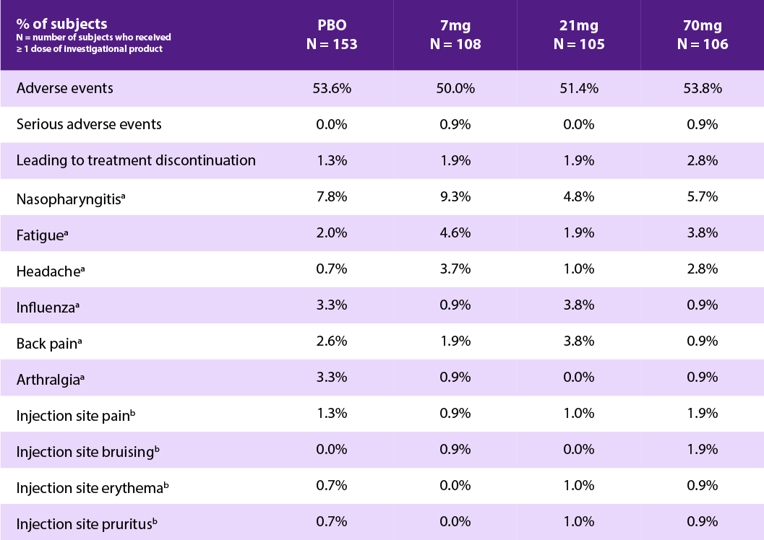
Erenumab (AMG 334) for prevention of episodic migraine: Safety and tolerability
Most adverse events (AEs) were mild to moderate
There were no serious AEs
There were no clinically significant clinical or laboratory findings
ª AEs in ≥ 3% of subjects in any group
^{b} Most frequent injection-site reactions in
≥ 0.6% overall
Sun H et al. Lancet Neurol 2016;15:382.

Slide 18
Erenumab (AMG 334) for prevention of episodic migraine: Conclusions
These results suggest that erenumab (AMG 334) might be a potential therapy for migraine prevention in patients with episodic migraine
The safety and tolerability profile of erenumab (AMG 334) supports further development
Sun H et al. Lancet Neurol 2016;15:382.

Slide 19
ALD403:
An IV CGRP monoclonal antibody

Slide 20
ALD403 for prevention of episodic migraine
Double-blind, randomized, placebo-controlled US trial in 174 patients with frequent episodic migraine
Episodic migraine was defined as 5-14 migraine days during the 28-day screening period
Randomization (1:1) to ALD403 1000mg i.v. (single dose) or placebo
No migraine preventive therapy was allowed during or 3 months before study (6 months for onabotulinumtoxinA)
Exclusions: History of regular use of (>7 days) any headache preventive therapy (as indicated); chronic tension-type headache; hypnic headache; hemicrania continua, new daily persistent headache, or basilar, sporadic, or familial hemiplegic migraine
Primary endpoint: Safety
Primary efficacy endpoint: Change from baseline to weeks 5-8 in the frequency of migraine days (any day with migraine/probably migraine with or without aura)
Dodick DW, et al. Lancet Neurol 2014; 13: 1100.
Notes:
ALD403 for prevention of episodic migraine
This was a randomised, double-blind, placebo-controlled, exploratory, proof-of-concept phase 2 trial in 174 patients with frequent episodic migraine ; 163 (mean age 39 years, 80% women) received at least one dose of study treatment.
The primary objective was to assess safety at 12 weeks after IV infusion (ALD403 or placebo).
The primary efficacy endpoint was the change from baseline to weeks 5–8 in the frequency of migraine days (defined as any day with migraine or probable migraine with or without aura), as recorded in patient electronic diaries.
Reference
Dodick DW et al. Safety and efficacy of ALD403, an antibody to calcitonin gene-related peptide, for the prevention of frequent episodic migraine: a randomised, double-blind, placebo-controlled, exploratory phase 2 trial. Lancet Neurol 2014;13:1100.

Slide 21
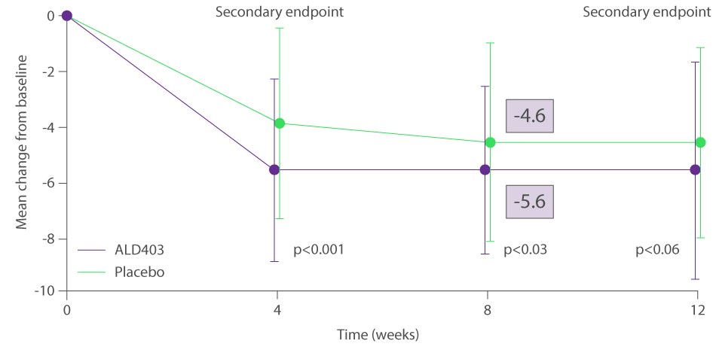
ALD403 for prevention of episodic migraine: Primary endpoint analysis, Weeks 5-8
Mean (standard deviation) migraine days at baseline:
8.4 (2.1) days in the ALD403 group and 8.8 (2.7) days in the placebo group
Dodick DW, et al. Lancet Neurol 2014; 13: 1100.
Notes:
ALD403 for prevention of episodic migraine: Primary endpoint analysis, weeks 5-8
The primary efficacy analysis included data for all patients who completed the electronic diary on more than 92% of days, i.e. 80 patients in the placebo group and 78 patients in the ALD403 group.
A single dose of ALD403 was associated with a significantly greater mean change in migraine days between baseline and weeks 5-8 compared with placebo (-5.6 [standard deviation 3.0] versus -4.6 [3.6] days, treatment difference -1.0 days, 95% CI -2.0 to 0.1, one-sided p-value 0.0306).
The sensitivity analysis using the last observation carried forward approach was similar (-5.6 [3.0] days with ALD403 versus -4.6 [3.6] with placebo, treatment difference -1.0 days, 95% CI -2.0 to 0.1, p=0.026).
Reference
Dodick DW et al. Safety and efficacy of ALD403, an antibody to calcitonin gene-related peptide, for the prevention of frequent episodic migraine: a randomised, double-blind, placebo-controlled, exploratory phase 2 trial. Lancet Neurol 2014;13:1100.

Slide 22
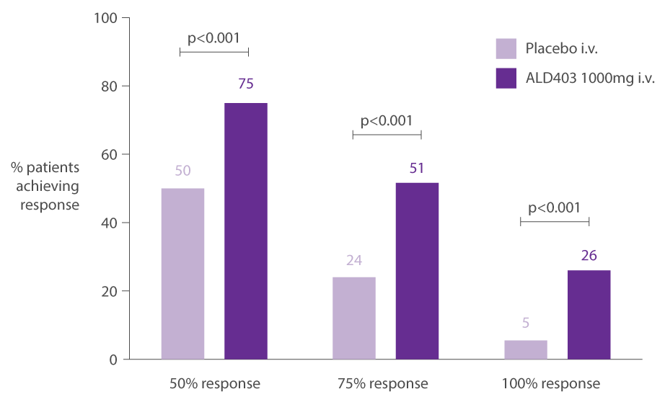
ALD403 for prevention of episodic migraine: Early responder rates (weeks 1-4)
Dodick DW, et al. Lancet Neurol 2014; 13: 1100.
Notes:
ALD403 for prevention of episodic migraine: Early responder rates (weeks 1-4)
A key secondary efficacy endpoint was the responder rate, i.e. the proportion of patients with a 50% or 75% reduction in migraine days at weeks 1-4, 5-8, and 9-12, and 100% responder rates at weeks 1-4, 5-8 and 9-12.
For all time points, responder rates were numerically higher with ALD403 than placebo. Notably, there was evidence of significant early response (weeks 1-4) with ALD403 across all categories of responder rate: 75% with ALD403 vs. 50% with placebo for 50% responder rate; 51% with ALD403 vs. 24% with placebo for 75% responder rate; and 26% with ALD403 vs. 5% with placebo for 100% responder rate.
Reference
Dodick DW et al. Safety and efficacy of ALD403, an antibody to calcitonin gene-related peptide, for the prevention of frequent episodic migraine: a randomised, double-blind, placebo-controlled, exploratory phase 2 trial. Lancet Neurol 2014;13:1100.

Slide 23
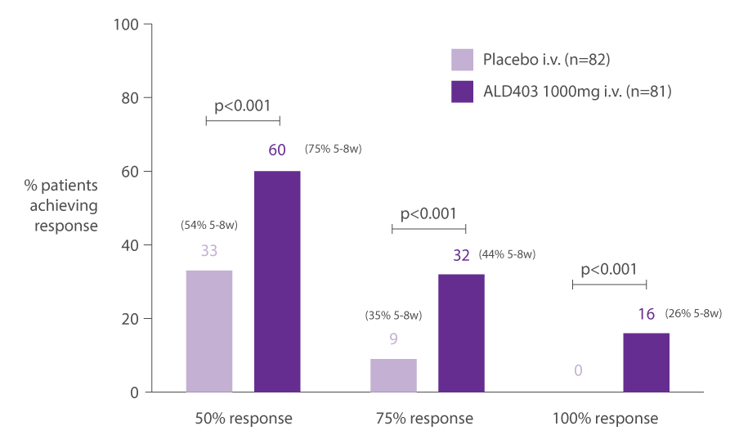
ALD403 for prevention of episodic migraine:
Responder rates (weeks 1-12) post-hoc analysis
Dodick DW, et al. Lancet Neurol 2014; 13: 1100
Notes:
ALD403 for prevention of episodic migraine: Responder rates (weeks 1-12) Post-hoc analysis
Because of the importance of responder rates as an outcome measure in migraine prevention trials, a post-hoc responder endpoint that assessed overall responder status from week 1 to week 12 was evaluated. This endpoint classified a patient as a 50% responder if they were a 50% responder for each of the 4-week intervals
(weeks 1–4, 5–8, and 9–12). Similar post hoc responder endpoints were used for 75% and 100% responder rates.
For all these post hoc responder rates, treatment with ALD403 led to significantly higher response rates than placebo; over the 12 weeks, 11 patients treated with ALD403 had no migraine attacks.
Reference
Dodick DW et al. Safety and efficacy of ALD403, an antibody to calcitonin gene-related peptide, for the prevention of frequent episodic migraine: a randomised, double-blind, placebo-controlled, exploratory phase 2 trial. Lancet Neurol 2014;13:1100.

Slide 24
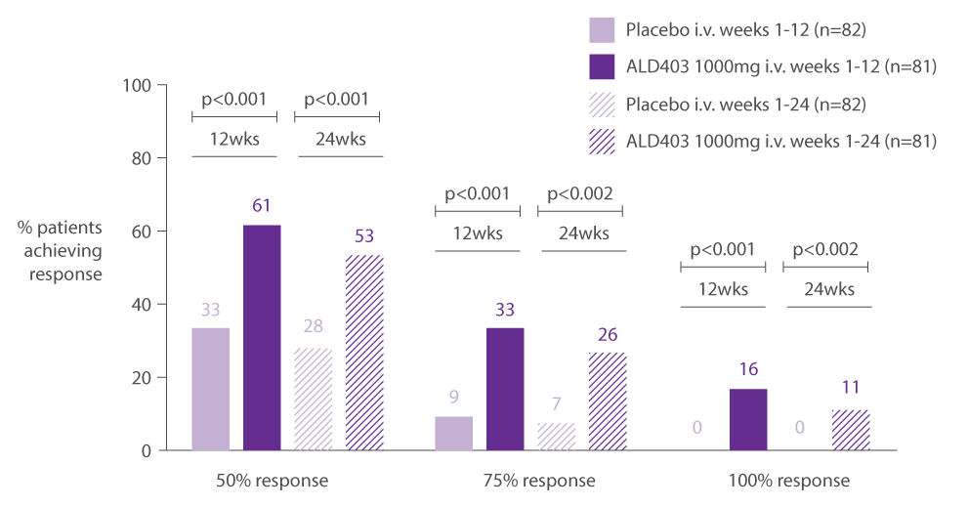
ALD403 for prevention of episodic migraine: Post-hoc analysis at 6 months
Smith J, et al. Cephalalgia 2015; 35: 4-5
Notes:
ALD403 for prevention of episodic migraine: Post hoc analysis at 6 months
In a post hoc analysis, a single dose of ALD403 provided sustained relief from migraine for 6 months; 26% of patients treated with ALD403 were 75% responders (vs. 33% at 12 weeks) and 11% of patients treated with ALD403 were 100% responders (vs. 16% at 12 weeks).
Reference
Smith J et al. Cephalalgia 2015; 35(6S) 4-5.

Slide 25
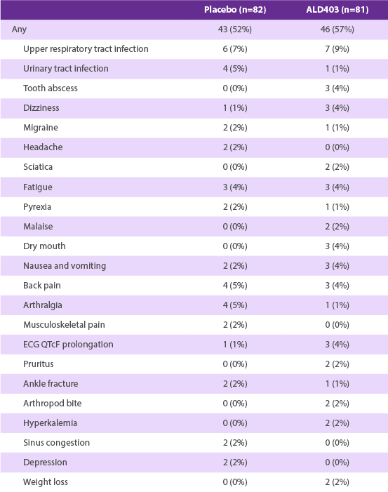
ALD403 for prevention of episodic migraine: Adverse event profile
The Table shows adverse events (AEs) reported in >2% of patients in either treatment group.
The most frequent AEs in each group were upper respiratory tract infection, urinary tract infection, fatigue, back pain, nausea and vomiting, and arthralgia. Most were mild to moderate
No infusion reactions were reported
There were 6 AEs in 3 patients; none were considered related to the study treatment
There were 11/81 reports of anti-drug antibodies during the study; these had no effect on tolerability or efficacy
Dodick DW, et al. Lancet Neurol 2014; 13: 1100.
Notes:
ALD403 for prevention of episodic migraine: Adverse event profile
The adverse event profile and safety findings indicated that a single IV dose of ALD403 1000mg was generally safe and well tolerated. Most adverse events were mild to moderate in severity. No patients discontinued the study due to adverse events, and there were no serious treatment-related adverse events.
Reference
Dodick DW et al. Safety and efficacy of ALD403, an antibody to calcitonin gene-related peptide, for the prevention of frequent episodic migraine: a randomised, double-blind, placebo-controlled, exploratory phase 2 trial. Lancet Neurol 2014;13:1100.

Slide 26
ALD403 for prevention of episodic migraine: Conclusions
There were no safety concerns with a single i.v. dose of ALD403 1000mg
The study provided preliminary evidence of the efficacy of ALD403 for prevention of migraine in patients with frequent episodic migraine
These findings support further evaluation of ALD403 for prevention of migraine
Dodick DW et al. Lancet Neurol 2014;13:1100.

Slide 27
Galcanezumab (LY2951742):
A CGRP monoclonal antibody

Slide 28
Galcanezumab (LY2951742) for prevention of migraine: Study design
Double-blind, randomized, placebo-controlled phase 2 proof-of-concept trial in 218 patients
Episodic migraine: 4 to 14 migraine days/month
Randomization (1:1): LY2951742 150mg or placebo SC every 2 weeks for 12 weeks
No migraine preventive medications for 30 days before baseline (4 months for onabotulinumtoxinA) and during double-blind treatment
Exclusions: History of chronic migraine or other migraine subtypes; history of headache other than migraine or tension-type headache; lack of response to >2 adequately dosed migraine preventive medications
Primary endpoint: Mean change in number of migraine days per 28-day period assessed at 9-12 weeks
Dodick DW, et al. Lancet Neurol 2014; 13: 885.
Notes:
Galcanezumab (LY2951742) for prevention of migraine: study design
This phase 2 trial consisted of 4 periods:
Screening (discontinuation of any existing migraine preventive medications, ≥30 days;
Baseline, to assess study eligibility on the basis of frequency of migraine days (28 days)
Double-blind treatment period (12 weeks)
Follow-up period (12 weeks).
The primary efficacy endpoint was the mean change from baseline in the number of migraine headache days over a 28-day period (weeks 9-12).
Secondary endpoints included the mean change from baseline in the number of days with headache, or migraine/probable migraine; migraine attacks/28-day period; and the proportion of responders (patients with >50% reduction in the number of migraine headache days in a 28-day period).
Reference
Dodick DW et al. Safety and efficacy of LY2951742, a monoclonal antibody to calcitonin gene-related peptide, for the prevention of migraine: a phase 2, randomised, double-blind, placebo-controlled study. Lancet Neurol 2014; 13: 885.

Slide 29
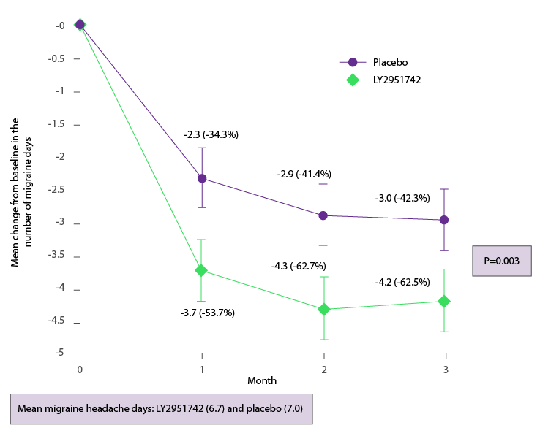
Galcanezumab (LY2951742) for prevention of migraine: Primary endpoint analysis
Dodick DW, et al. Lancet Neurol 2014; 13: 885
Notes:
Galcanezumab (LY2951742) for prevention of migraine: Primary Endpoint analysis
Treatment with LY2951742 led to significantly greater change in the primary endpoint than placebo. The mean [standard deviation] change from baseline to week 12 in the number of migraine headache days was -4.2 (3.1, 62.5% decrease) with LY2951742 vs. -3.0 (3.0, 42.3% decrease) with placebo, (least squares mean difference -1.2, 90% CI -1.9 to -0.6, p=0.003).
Reference
Dodick DW et al. Safety and efficacy of LY2951742, a monoclonal antibody to calcitonin gene-related peptide, for the prevention of migraine: a phase 2, randomised, double-blind, placebo-controlled study. Lancet Neurol 2014; 13: 885.

Slide 30
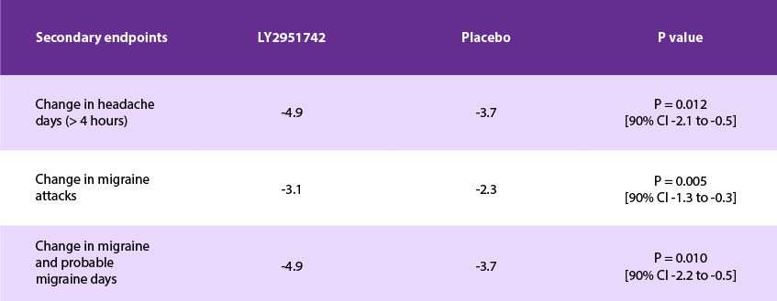
Galcanezumab (LY2951742) for prevention of migraine: Secondary efficacy endpoints
Mean change at month 3 compared with baseline
Dodick DW, et al. Lancet Neurol 2014; 13: 885.
Notes:
Galcanezumab (LY2951742) for prevention of migraine: Secondary Efficacy endpoints
Treatment with galcanezumab was also associated with significant improvements in secondary efficacy endpoints, as summarised in the slide.
Reference
Dodick DW et al. Safety and efficacy of LY2951742, a monoclonal antibody to calcitonin gene-related peptide, for the prevention of migraine: a phase 2, randomised, double-blind, placebo-controlled study. Lancet Neurol 2014; 13: 885.
AMEND FOR ALI:
CHANGE IN MIGRAINE/PROBABLE MIGRAINE DAYS -4.8 AND -3.5

Slide 31
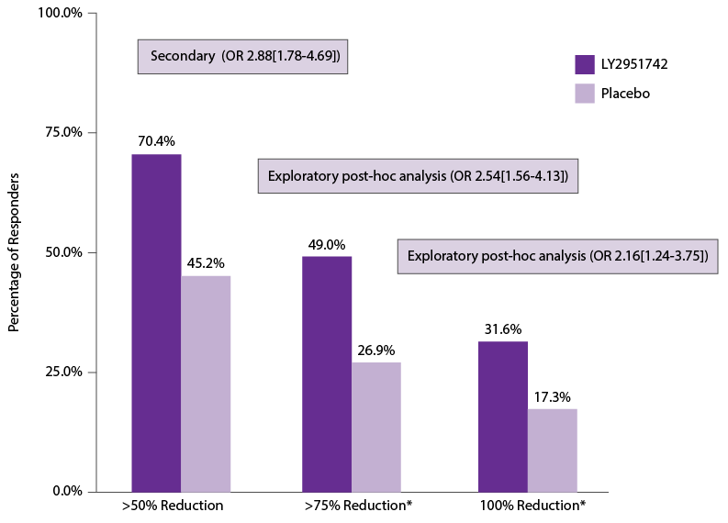
Galcanezumab (LY2951742) for prevention of migraine: Responder rates
Dodick DW, et al. Lancet Neurol 2014; 13: 885.
Notes:
Galcanezumab (LY2951742) for prevention of migraine: Responder rates
In the secondary endpoint analysis, there were more >50% responders in the LY2951742 group than in the placebo group (odds ratio 2.88, 90% CI 1.78–4.69).
Additionally, in an exploratory post hoc analysis, 75% and 100% responder rates were more than 2-fold higher with LY2951742 than placebo.
Reference
Dodick DW et al. Safety and efficacy of LY2951742, a monoclonal antibody to calcitonin gene-related peptide, for the prevention of migraine: a phase 2, randomised, double-blind, placebo-controlled study. Lancet Neurol 2014; 13: 885.

Slide 32
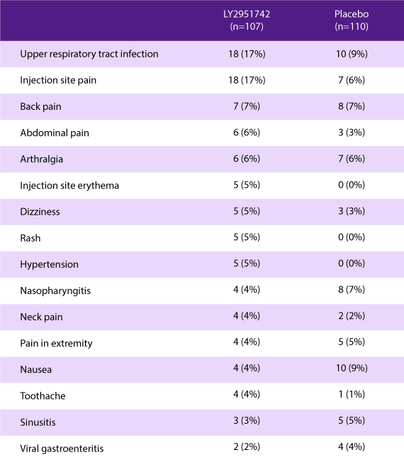
Galcanezumab (LY2951742) for prevention of migraine: Adverse event profile
The Table shows adverse events (AEs) reported by >4% of patients
Overall, AEs were reported by 72% (LY2951742) and 67% (placebo)
6 serious AEs (4 placebo; 2 LY2951742) were reported but none were considered treatment- related
Anti-drug antibodies were found in 8 patients at screening (and 20 patients at the end of the study)
Dodick DW, et al. Lancet Neurol 2014; 13: 885.
Notes:
Galcanezumab (LY2951742) for prevention of migraine: Adverse event profile
Adverse events were reported to a similar extent in the two groups, with upper respiratory infections and viral infections the most common type of event in each group.
Reference
Dodick DW et al. Safety and efficacy of LY2951742, a monoclonal antibody to calcitonin gene-related peptide, for the prevention of migraine: a phase 2, randomised, double-blind, placebo-controlled study. Lancet Neurol 2014; 13: 885.

Slide 33
Galcanezumab (LY2951742) for prevention of migraine: Conclusions
This study provides preliminary evidence that LY2951742 might be beneficial in migraine prevention
LY2951742 was generally well tolerated
Dodick DW, et al. Lancet Neurol 2014; 13: 885.

Slide 34
TEV-48125:
A CGRP monoclonal antibody

Slide 35
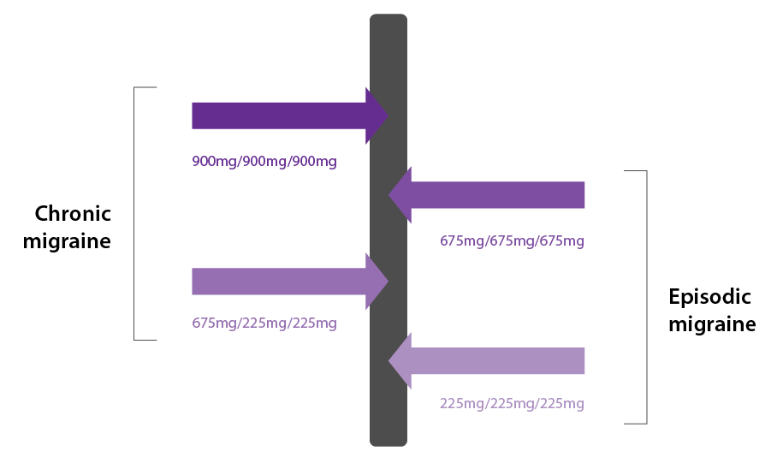
TEV-48125 doses used in phase 2

Slide 36
TEV-48125 for prevention of episodic migraine
Randomized, double-blind, phase 2b study in 297 patients with 8–14 headache days per month
Randomization 1:1:1; stratified by sex and use of concomitant preventive therapy
Treatment with 3 x 28-day treatment cycles of SC 225mg TEV-48125, 675mg TEV-48125, or placebo (4 SC injections - double dummy)
Patients allowed to use 1 preventive medication for at least 2 months before screening visit, and acute migraine drugs up to 14 days per month
Exclusions: > 4 days/month of opioid or butalbital use; failed ≥3 preventive medications
Primary endpoint: Change from baseline in migraine days (migraine/probable migraine >4 hours OR treated with migraine-specific drug) during the 3rd treatment cycle (weeks 9–12)
Bigal ME et al. Lancet Neurol 2015; 14: 1081.
Notes:
TEV-48125 for prevention of episodic migraine: Study design
Key aspects of the study design are summarised in the slide.
After a 28 day run-in phase, eligible subjects were randomly assigned (1:1) to receive either TEV-48125 675mg or placebo; Once the 675mg cohort was completed, subjects were randomly assigned (9:1) to receive either TEV 48125 225mg or placebo, to give a final randomisation schedule of about 1:1:1.
Reference
Bigal ME et al. Safety, tolerability, and efficacy of TEV-48125 for preventive treatment of high-frequency episodic migraine: a multicentre, randomised, double-blind, placebo-controlled, phase 2b study. Lancet Neurol 2015;14:1081.

Slide 37
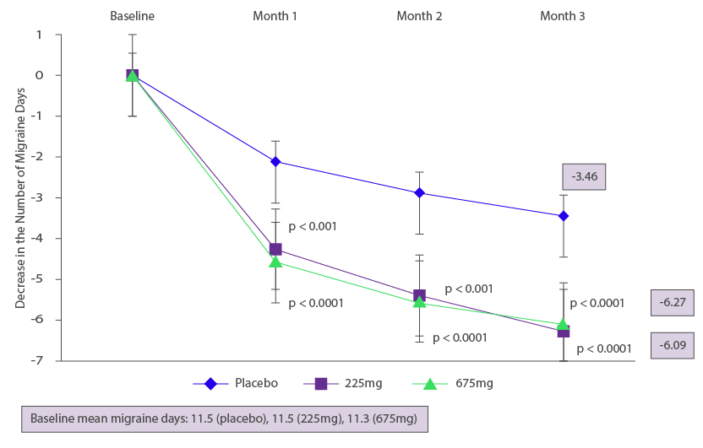
TEV-48125 for prevention of episodic migraine:
Primary endpoint analysis (Weeks 9-12)
Bigal ME, et al. Lancet Neurology 2015; 14: 1081.
Notes:
TEV-48125 for prevention of episodic migraine:
Primary Endpoint analysis (Weeks 9-12)
The least square mean (LSM) change (standard deviation) in the primary endpoint (number of migraine-days) from baseline to weeks 9–12 was –3.46 days (5.40) in the placebo group, –6.27 days (5.38) in the 225mg dose group, and –6.09 days (5.22) in the 675mg dose group.
The LSM difference in the reduction of migraine-days between the placebo and 225mg dose groups was –2.81 days (95% CI –4.07 to –1.55;p<0·0001). The corresponding difference between the placebo and 675mg dose group was –2.64 days (–3.90 to -1.38;p<0·0001).
Reference
Bigal ME et al. Safety, tolerability, and efficacy of TEV-48125 for preventive treatment of high-frequency episodic migraine: a multicentre, randomised, double-blind, placebo-controlled, phase 2b study. Lancet Neurol 2015;14:1081.

Slide 38
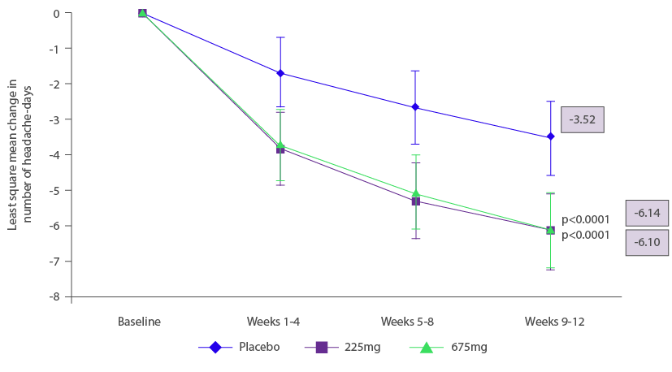
TEV-48125 for prevention of episodic migraine: Secondary endpoint: Headache Days
Bigal ME, et al. Lancet Neurology 2015; 14: 1081.
Notes:
TEV-48125 for prevention of episodic migraine: Secondary Endpoint: Headache Days
Least squares mean differences for the reduction in headache-days were –2.63 days (–3.91 to –1.34; p<0·0001) between the placebo group and 225mg dose group and –2.58 days (–3.87 to 1.30; p<0·0001) between the placebo group and 675mg dose group.
Reference
Bigal ME et al. Safety, tolerability, and efficacy of TEV-48125 for preventive treatment of high-frequency episodic migraine: a multicentre, randomised, double-blind, placebo-controlled, phase 2b study. Lancet Neurol 2015;14:1081.

Slide 39
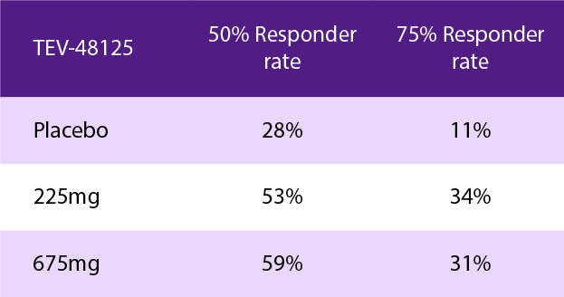
TEV-48125 for prevention of episodic migraine: Responder rates (Weeks 9-12), post-hoc analysis
Bigal ME, et al. Lancet Neurology 2015; 14: 1081.
Notes:
TEV-48125 for prevention of episodic migraine: Responder Rates (Weeks 9-12), post hoc analysis
In a post-hoc analysis, 50% responder rates (50% reduction in the number of migraine days) were about 2-fold higher with TEV-48125 compared with placebo (53% vs. 28% with 225mg dose group, p=0·0005) and 59% vs. 28% in the 675mg dose group, p<0·0001). Similarly, 75% responder rates were significantly higher with TEV-48125 than placebo (p=0·0001 for the 225mg dose group and p=0·0008 for the 675mg dose group).
Reference
Bigal ME et al. Safety, tolerability, and efficacy of TEV-48125 for preventive treatment of high-frequency episodic migraine: a multicentre, randomised, double-blind, placebo-controlled, phase 2b study. Lancet Neurol 2015;14:1081.

Slide 40
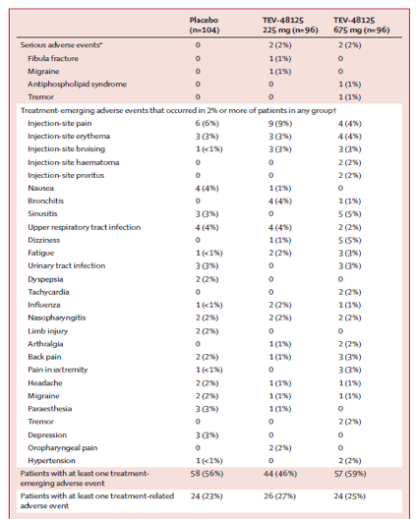
TEV-48125 in episodic migraine:
Adverse event profile
The most common treatment-emergent adverse events (AEs) were mild injection site pain or erythema; these were similar in all groups
There were 3 serious AEs (fibular fracture and migraine with hypertensive crisis in the 225mg dose group; 1 antiphospholipid antibody and tremor in the 675mg dose group)
2 subjects had anti-drug antibodies before and after drug administration
Bigal ME, et al. Lancet Neurology 2015; 14: 1081.
Notes:
TEV-48125 in episodic migraine: Adverse event profile
Both doses of TEV-48125 were safe and tolerable. The overall incidence of adverse events and treatment-related adverse events were similar in the TEV-48125 and placebo groups, with little difference in severity. No specific pattern of adverse events emerged.
Reference
Bigal ME et al. Safety, tolerability, and efficacy of TEV-48125 for preventive treatment of high-frequency episodic migraine: a multicentre, randomised, double-blind, placebo-controlled, phase 2b study. Lancet Neurol 2015;14:1081.

Slide 41
TEV-48125 for prevention of chronic migraine: Study design
Randomized, double-blind, double-dummy, phase 2b study in 264 patients
Randomization 1:1:1 to TEV-48125 675/225mg TEV-48125 900mg or placebo. Randomization was stratified by sex and use of concomitant preventive therapy
Patients using 1-2 preventive therapies ≥3 months prior to screening were eligible
Patients were excluded if onabotulinumtoxinA was used 6 months before screening, or they had used >4 days opioids/butalbital during the run-in phase, or had failed ≥3 preventive medications
No upper limit on acute drug use and patients with continuous (unremitting) headache were not excluded
Primary efficacy endpoint: Change from baseline in the number of headache-hours (weeks 9–12)
Secondary efficacy endpoint: Change in the number of moderate or severe headache-days (weeks 9–12)
Bigal ME, et al. Lancet Neurology 2015; 14: 1091.
Notes:
TEV-48125 for prevention of chronic migraine: Study design
This study compared the safety, tolerability, and efficacy of two doses of TEV-48125
(675/225mg and 900mg) with placebo given subcutaneously once every 28 days for 3 months. In the 675/225mg dose group, 675mg was given in the first treatment cycle and 225mg in the second and third treatment cycles. Key features of the study design are summarised.
Reference
Bigal ME et al. Safety, tolerability, and efficacy of TEV-48125 for preventive treatment of chronic migraine: a multicentre, randomised, double-blind, placebo-controlled, phase 2b study. Lancet Neurol 2015;14:1091.

Slide 42
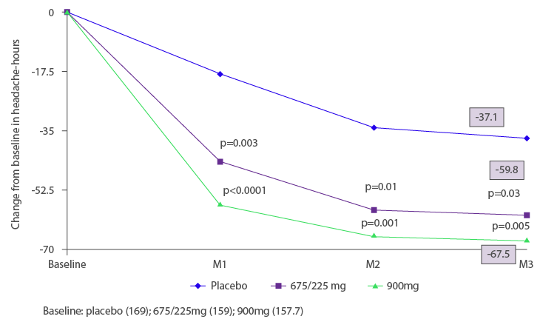
TEV-48125 for prevention of chronic migraine: Primary endpoint analysis
Bigal ME, et al. Lancet Neurol 2015;14:1091.
Notes:
TEV-48125 for prevention of chronic migraine: Primary Endpoint analysis
The mean change from baseline in the number of headache-hours during weeks 9–12 was –59.8 h in the 675/225mg group and –67.51 h in the 900mg group, compared with –37.10 h in the placebo group.
Reference
Bigal ME et al. Safety, tolerability, and efficacy of TEV-48125 for preventive treatment of chronic migraine: a multicentre, randomised, double-blind, placebo-controlled, phase 2b study. Lancet Neurol 2015;14:1091.

Slide 43
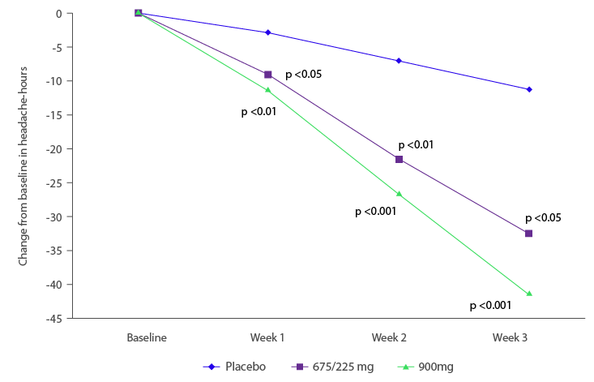
TEV-48125 in prevention of chronic migraine: Reduction in headache-hours
Bigal ME, et al. Lancet Neurol 2015;14:1091.
Notes:
TEV-48125 for prevention of chronic migraine: Primary Endpoint analysis
The reduction in the number of headache-hours from baseline to weeks 9–12 was 22% decrease with placebo, 38% with TEV-48125 675/225mg (p<0.05 vs. placebo) and 43% with TEV-48125 900mg (p<0.001 vs. placebo).
Reference
Bigal ME et al. Safety, tolerability, and efficacy of TEV-48125 for preventive treatment of chronic migraine: a multicentre, randomised, double-blind, placebo-controlled, phase 2b study. Lancet Neurol 2015;14:1091.

Slide 44
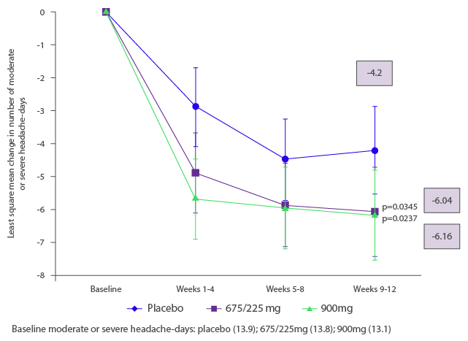
TEV-48125 for prevention of chronic migraine: Secondary endpoint: moderate or severe headache-days
Bigal ME, et al. Lancet Neurology 2015; 14: 1081.
Notes:
TEV-48125 for prevention of chronic migraine: Secondary Endpoint: Moderate or Severe Headache Days
Analysis using analysed using mixed-effects model repeated measurement showed that the reduction in moderate or severe headache-days was significantly larger in both TEV 48125 dose cohorts than in the placebo group.
Reference
Bigal ME et al. Safety, tolerability, and efficacy of TEV-48125 for preventive treatment of chronic migraine: a multicentre, randomised, double-blind, placebo-controlled, phase 2b study. Lancet Neurol 2015;14:1091.

Slide 45
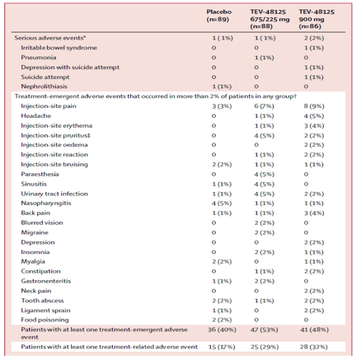
TEV-48125 in chronic migraine: Adverse event profile
The most common adverse events (AEs) were mild injection site pain and pruritus
There was 1 serious AE in the placebo group, 1 in the 675/225mg group and 2 in the 900mg group. None of these were considered study treatment-related
2 subjects had anti-drug antibodies prior to the study
Bigal ME, et al. Lancet Neurol 2015;14:1091.
Notes:
TEV-48125 in chronic migraine: Adverse event profile
TEV-48125 was well tolerated, and no safety concerns apparent over the 12 week duration of exposure.
Reference
Bigal ME et al. Safety, tolerability, and efficacy of TEV-48125 for preventive treatment of chronic migraine: a multicentre, randomised, double-blind, placebo-controlled, phase 2b study. Lancet Neurol 2015;14:1091.

Slide 46
TEV-48125 in episodic and chronic migraine: Conclusions
TEV-48125 given by subcutaneous injection every 28 days seems to be tolerable and effective in each clinical setting
These findings support further development of TEV-48125 for the preventive treatment of episodic and chronic migraine
Bigal ME, et al. Lancet Neurol 2015;14:1091.

Slide 47
CGRP monoclonal antibodies: Precision medicine for migraine
Developed for migraine-specific targets
Good efficacy in episodic and chronic migraine, with a subgroup of patients showing 75% response rates
Tolerability data to date are promising, although long-term safety needs to be established
Offer potential to tailor acute or preventive migraine therapy to individual patients
Provide new hope for migraine patients for whom current options are either ineffective or poorly tolerated

Slide 48
CARDIOVASCULAR SAFETY

Slide 49
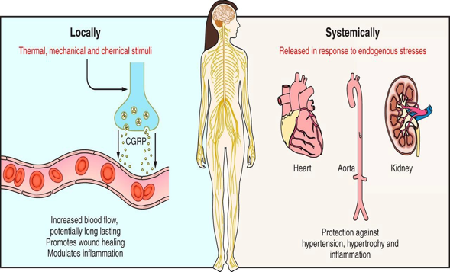
CGRP and the cardiovascular system
Ref: Russell FA et al. Physiol Rev 2014;94:1099.
Notes:
CGRP and the cardiovascular system
The slide summarises local and systemic mechanisms involving CGRP in cardiovascular regulation. Local release of CGRP from the peripheral sensory nerve endings increases blood flow, suggesting involvement in neurogenic inflammation and as a regulatory factor in inflammation, with potential for enhanced wound healing.
Systemically, CGRP is not considered to have a major role in the normal individual.
Reference
Russell F et al. Calcitonin Gene-Related Peptide: Physiology and Pathophysiology. Physiol Rev 2014;94:1099.

Slide 50
Potential cardiovascular concerns of CGRP inhibition
Vasoconstriction
No effect on vasoconstriction in vitro¹, coronary arteries under ischemic conditions (dog)², regional or global coronary blood flow in humans³
Inhibit vasodilation
No effect of telcagepant on arterial vasodilation in healthy men after administration of GTN⁴
Inhibit compensatory vasodilation during ischemia
In subjects with stable angina, no difference between telcagepant and placebo in total TMET, maximum exercise HR, or time to 1mm ST-segment depression⁵
Refs: 1 Chan KY et al. J Pharmacol Exp Ther 2010;334:746; 2 Lynch JJ et al. Eur J Pharmacol 2009;623:96
3 Petersen KA et al. Cephalalgia 2005;25:129; 4 Van De Schueren BJ et al. Br J Pharmacol 2011;71:708
5 Chaitman BR et al. Clin Pharmacol Ther 2012;91:459.

Slide 51
CGRP and ischemia: Potential effects
Protective against hypertension
Neuroprotection after myocardial or cerebral ischemia
Prevention of vasospasm after subarachnoid hemorrhage?
Long-term cardiovascular safety studies of CGRP monoclonal antibody therapy are needed

