Slide 1


A Background
THERAPEUTIC Monoclonal
Antibodies:

Slide 2
What are monoclonal antibodies?
Monoclonal antibodies are produced from a single hybridoma cell line and are therefore identical to the parent cell
Human or “fully human” monoclonal antibodies (mAbs) have been developed to reduce immunogenicity
Silberstein S et al. , Headache 2015;55:1171.
Notes:
What are monoclonal antibodies?
Monoclonal antibodies (mAbs) are antibodies that are made by identical immune cells that are all clones of a unique parent cell. Because they are identical, their specificities can be better predicted than those of polyclonal antibodies, which are made by several different immune cells.
Reference
Silberstein S et al. Therapeutic monoclonal antibodies: what headache specialists need to know. Headache 2015;55:1171.

Slide 3
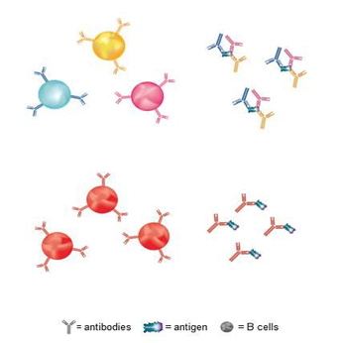
Polyclonal versus monoclonal antibodies
Polyclonal antibodies (pAbs)
Are from multiple B-cells that recognize multiple antigen epitopes
Monoclonal antibodies (mAbs)
Are from a single B-cell line and recognize one antigen epitope
Silberstein S et al. , Headache 2015;55:1171.
Notes:
Polyclonal versus monoclonal antibodies
The immune response to an antigen generally involves the activation of multiple B-cells all of which target a specific epitope, or antigenic determinant, on that antigen. Consequently, a large number of antibodies are produced with different specificities and epitope affinities; these are known as polyclonal antibodies.
In contrast, monoclonal antibodies represent a single B lymphocyte generating antibodies to one specific epitope.
Reference
Silberstein S et al. Therapeutic monoclonal antibodies: what headache specialists need to know. Headache 2015;55:1171

Slide 4
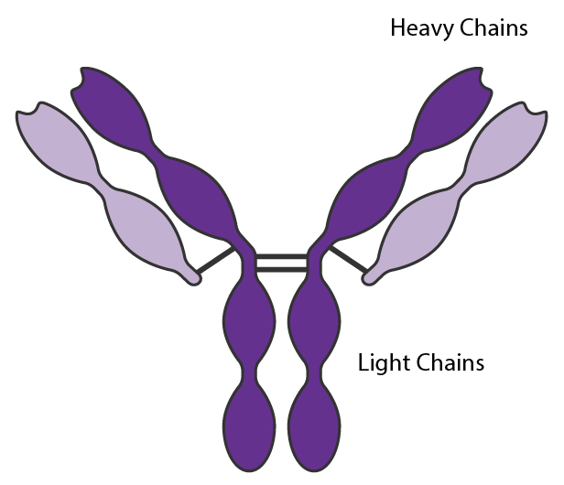
Structure of the antibody: Immunoglobulin (Ig) glycoprotein
The antibody has a Y-shaped structure, composed of 2 identical heavy chains connected by disulfide bonds to 2 identical light chains
Silberstein S et al. , Headache 2015;55:1171.
Notes:
Structure of the antibody: immunoglobulin (Ig) glycoprotein
Antibodies are large glycoproteins (immunoglobulins) which are composed of 2 identical heavy chains connected through disulfide bonds to 2 identical light chains. These form the classic Y-shaped structure.
Both chains contain variable and constant regions. The light chain contains 1 variable and 1 constant domain, while the heavy chain contains 1 variable domain and 3 constant domains.
Reference
Silberstein S et al. Therapeutic monoclonal antibodies: what headache specialists need to know. Headache 2015;55:1171

Slide 5
Antibody isotypes
Five different isotypes exist in humans:
IgA (α) often a dimer, protects mucosal and lymphoid tissues
IgD (δ) monomer, universally expressed on naive B-cells
IgE (ε) monomer, mediates parasitic infections and allergic reactions
IgG (γ) monomer, involved in the secondary phase of the immune response, occurs in 80% of all antibodies
IgM (µ) pentamer, first to appear after an infection
Each subclass has a different ability to activate host immune function, and thus can be tailored to a particular disease
Silberstein S et al. , Headache 2015;55:1171.
Notes:
Antibody isotypes
Five different immunoglobulin isotypes or families exist in humans: Ig alpha (IgA), Ig delta (IgD), Ig epsilon (IgE), Ig gamma (IgG), and Ig mu (IgM). The constant region is the same in all antibodies of the same family.
Reference
Silberstein S et al. Therapeutic monoclonal antibodies: what headache specialists need to know. Headache 2015;55:1171

Slide 6
Most antibodies are immunoglobulin G (IgG)
Nearly all marketed antibody drugs are IgG
Human IgG2 and IgG4 poorly support effector functions
There are few human IgG3 molecules in clinical development:
  Hinge region is longer and more prone to proteolysis than human IgG1, IgG2 and IgG4
Silberstein S et al. , Headache 2015;55:1171.
Notes:
Most antibodies are immunoglobulin G (IgG)
Therapeutic monoclonal antibodies are composed of IgG isotypes. These can be further classified to IgG1–IgG4. Each subclass has a different ability to activate host immune function, allowing this to be tailored to a specific disease.
Reference
Silberstein S et al. Therapeutic monoclonal antibodies: what headache specialists need to know. Headache 2015;55:1171

Slide 7
Human IgG receptors (FcγR)
Divided into three classes
  FcγRI (CD64)
  FcγRII (CD32) subdivided into
    FcγRIIa (activating), FcγRIIb (inhibitory) and FcγRIIc (activating)
  FcγRIII(CD16) subdivided into
    FcγRIIIa (activating) and FcγRIIIb
FcγRIIa, FcγRIIIa, and FcγRIIIb activity is complicated by differential cell expression patterns and polymorphisms
IgG design must consider both IgG isotype and FcγR
Silberstein S et al. , Headache 2015;55:1171.
Notes:
Human IgG receptors
An IgG receptor is a protein found on the surface of certain cells, including B cells, that contribute to the protective functions of the immune system. Its name is derived from its binding specificity for a part of an antibody known as the Fc (Fragment, crystallizable) region.
The types of Fc receptors are classified based on the type of antibody that they recognize. All of the Fcγ receptors (FcγR) belong to the immunoglobulin superfamily but differ in their affinity for IgG.
Reference
Silberstein S et al. Therapeutic monoclonal antibodies: what headache specialists need to know. Headache 2015;55:1171

Slide 8
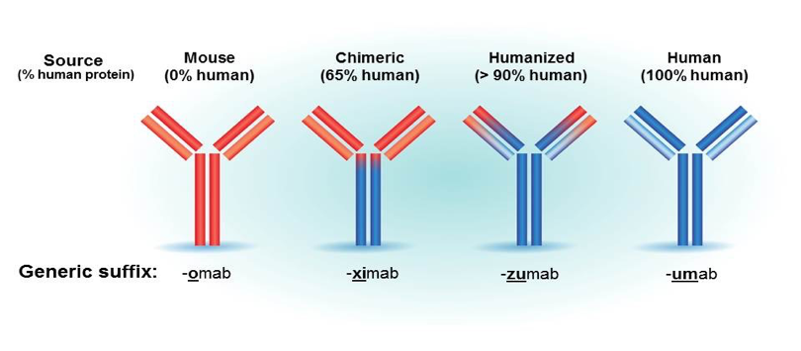
Nomenclature for therapeutic monoclonal antibodies
Silberstein S et al. , Headache 2015;55:1171.
Notes:
Nomenclature for therapeutic monoclonal antibodies
Therapeutic monoclonal antibodies have evolved to include fewer nonhuman
sequences, which are recognized as foreign. This is reflected in the nomenclature as shown in the slide.
Reference
Silberstein S et al. Therapeutic monoclonal antibodies: what headache specialists need to know. Headache 2015;55:1171

Slide 9
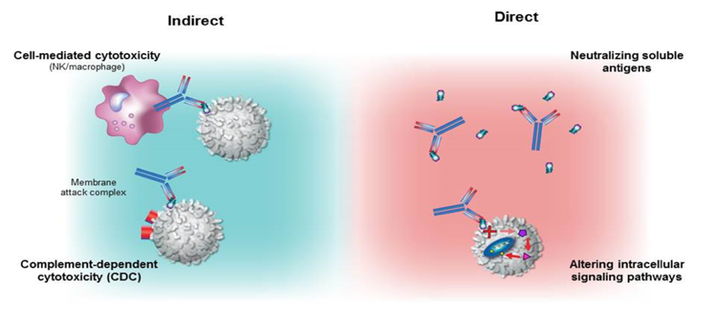
Mechanism of action of therapeutic monoclonal antibodies
Destroy target cells or alter target-cell function without cell destruction
Silberstein S et al. , Headache 2015;55:1171.
Notes:
Mechanism of action of therapeutic monoclonal antibodies
Therapeutic monoclonal antibodies are designed to either destroy target cells (as in cancer therapeutics) or to alter target-cell function without cell destruction (as in monoclonal antibodies to CGRP or its receptor).
Therapeutic monoclonal antibodies also have indirect mechanisms of action in which the
native effector function is harnessed to induce cell complement or cell-mediated toxicity by binding of the Fc region of the antibody to Fc receptors on effector cells of the immune system.
Reference
Silberstein S et al. Therapeutic monoclonal antibodies: what headache specialists need to know. Headache 2015;55:1171

Slide 10
Why therapeutic monoclonal antibodies need to be given parenterally
Large size and hydrophilicity
  Limit diffusion from gastrointestinal epithelium
Denatured in stomach and degraded
IV administration allows for rapid delivery of monoclonal antibodies
  Plasma concentrations are higher after IV than SC or IM administration
SC or IM administration: absorption by lymphatic system
  Slow lymph flow rate leads to slow absorption (1-8 days to peak plasma concentrations)
Antibodies are largely confined to vasculature
Silberstein S et al. , Headache 2015;55:1171.
Notes:
Why therapeutic monoclonal antibodies need to be given parenterally
Therapeutic monoclonal antibodies are large and hydrophilic, and also have a high propensity to denature in the stomach and degrade in the gastrointestinal tract. For these reasons, monoclonal antibodies need to be given via parenteral routes (IV, SC or IM). Concentrations attained by SC or IM administration are likely to be lower than those attained with IV administration.
Reference
Silberstein S et al. Therapeutic monoclonal antibodies: what headache specialists need to know. Headache 2015;55:1171

Slide 11
Therapeutic monoclonal antibody pharmacokinetics
Administered every 2 weeks or monthly: Human IgG1, 2, and 4 serum half-life is ~ 3 weeks
Factors affecting pharmacokinetics:
  Properties of antibody (e.g., origin, structure, size, concentration, affinity)
  Properties of the antigen or target (e.g., distribution, concentration)
  Patient characteristics (e.g., body mass index, sex, age, activity level, concurrent medications)
Silberstein S et al. , Headache 2015;55:1171.
Notes:
Therapeutic monoclonal antibody pharmacokinetics
Therapeutic monoclonal antibodies that are administered by extravascular routes (i.e. SC or IM) are absorbed via the lymphatic system, and take ~1–8 days to reach peak plasma concentrations. Concentrations attained via these routes are lower than attained with IV administration.
The average serum half-life of IgG antibodies (IgG 1, 2, and 4) in healthy humans is ~3 weeks, allowing them to be administered every 2 or 4 weeks.
Factors that affect antibody pharmacokinetics include the properties of the antibody, and antigen or target, and patient characteristics (eg, body mass index, sex, age, activity level, and concurrent medications).
Reference
Silberstein S et al. Therapeutic monoclonal antibodies: what headache specialists need to know. Headache 2015;55:1171

Slide 12
Therapeutic monoclonal antibody metabolism and elimination
Not filtered by kidney or excreted into urine intact
Catabolized into peptides and amino acids by reticuloendothelial system
Silberstein S et al. , Headache 2015;55:1171.
Notes:
Therapeutic monoclonal antibody metabolism and elimination
Due to their large size, monoclonal antibodies do not undergo renal excretion. Instead these therapeutics undergo catabolism into peptides and amino acids mainly by the reticuloendothelial system and target-mediated elimination.
Reference
Silberstein S et al. Therapeutic monoclonal antibodies: what headache specialists need to know. Headache 2015;55:1171

Slide 13
Therapeutic monoclonal antibodies versus small molecule therapies
Monoclonal antibodies | Small molecule therapies
Larger (~150kD); mainly extracellular | Smaller (<1 kD); able to enter cells and cross blood-brain barrier
Target-specific | Less specific
Parenteral administration | Oral administration possible
Longer dosing interval (half-life: days to weeks) | Shorter dosing interval (half-life: hours)
Not eliminated via hepatic, renal or biliary routes | Elimination via hepatic, renal and/or biliary routes
Lower risk of drug-drug interactions | Drug-drug interactions possible
Silberstein S et al. , Headache 2015;55:1171.
Notes:
Therapeutic monoclonal antibodies versus small molecule therapies
There are a number of differences between monoclonal antibodies and small molecule therapies, as summarized in the slide. Notably, therapeutic monoclonal antibodies are larger with mainly an extracellular site of action; have greater specificity; an extended half-life; and lower risk of drug-drug interactions. Importantly, therapeutic monoclonal antibodies do not cross the blood-brain barrier due to their large size.
Reference
Silberstein S et al. Therapeutic monoclonal antibodies: what headache specialists need to know. Headache 2015;55:1171

Slide 14
Safety of therapeutic monoclonal antibodies
Toxicity can be divided into 2 major categories:
Related to the antibody target
  Mechanism-based
  Target function and location
    May activate or suppress immune system, resulting in higher infection rates
Related to the host
  Immune system recognizes monoclonal antibodies as foreign, resulting in formation of anti-drug antibodies (ADAs)
Silberstein S et al. , Headache 2015;55:1171.
Notes:
Safety of therapeutic monoclonal antibodies
Toxicity related to therapeutic monoclonal antibodies may be due to the antibody target itself,
(i.e. mechanism-based toxicity) or the host immune response (i.e. immunogenicity).
Reference
Silberstein S et al. Therapeutic monoclonal antibodies: what headache specialists need to know. Headache 2015;55:1171

Slide 15
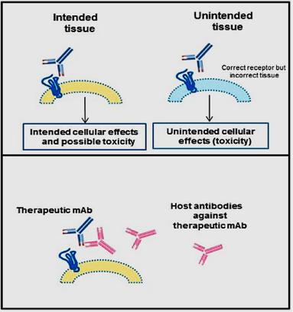
Safety of therapeutic monoclonal antibodies
Most adverse events are target-related
Intended tissue
Unintended tissue
Nonspecific toxicities
Antibodies against monoclonal antibodies
Silberstein S et al. , Headache 2015;55:1171.
Notes:
Safety of therapeutic monoclonal antibodies
Most adverse events with therapeutic monoclonal antibodies are target-related, such as those involving activation or suppression of the immune system (eg infection) or haematologic toxicity. In addition, target-related toxicity may occur when therapeutic monoclonal antibodies bind to other tissues that express the target antigen (eg dermatologic reactions).
Reference
Silberstein S et al. Therapeutic monoclonal antibodies: what headache specialists need to know. Headache 2015;55:1171

Slide 16
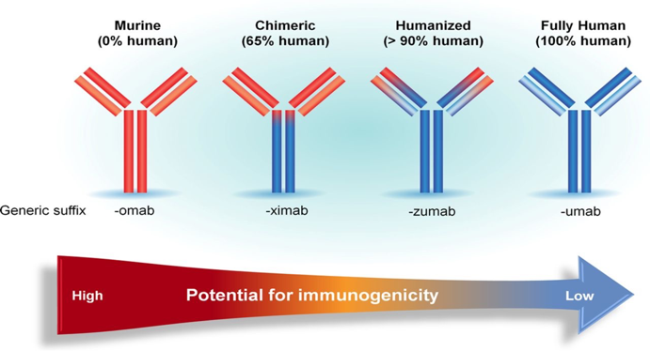
Humanization of therapeutic monoclonal antibodies has reduced their immunogenicity
Foltz I N et al. Circulation. 2013;127:2222-2230

Slide 17
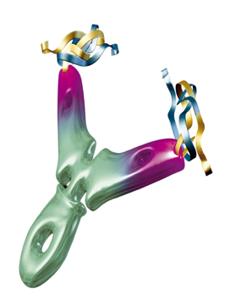
Benefits of therapeutic monoclonal antibodies
No toxic metabolites (broken down to constituent amino acids)
Restricted distribution
Pharmacokinetics are ideally suited for chronic disease prevention (half-life >14 days)
No off-target toxicity and overall tolerability is usually good (although dependent on mechanism of action)

