Slide 1


Calcitonin gene-related peptide
A background
To cgrp

Slide 2
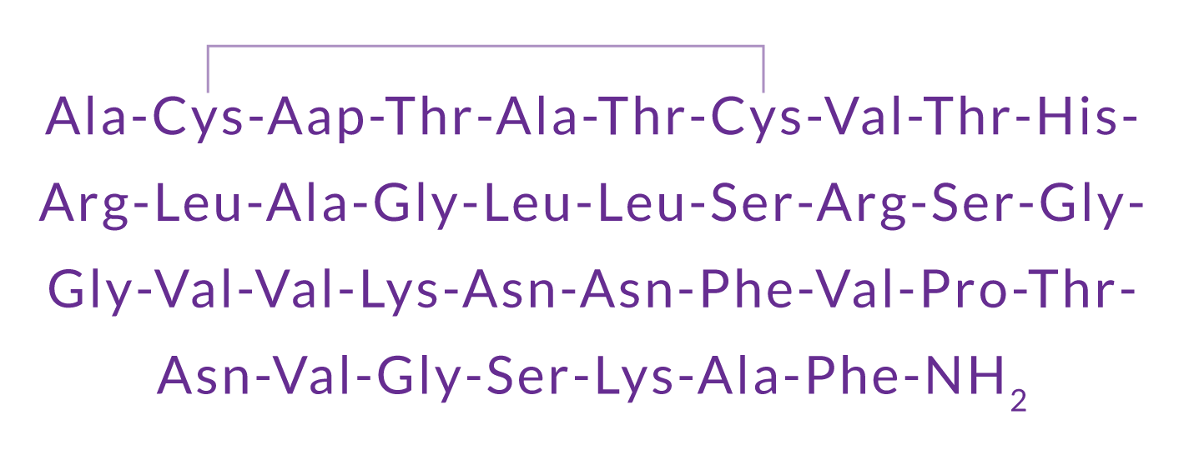


What is Calcitonin Gene-Related Peptide (CGRP)?
CGRP is a 37-amino acid neuropeptide derived from the gene encoding calcitonin.
It is a potent vasodilator and also functions as a messenger in nerve cells.
CGRP exists in two forms in humans:
CGRP is found in the peripheral and central nervous systems. This is formed from the alternative splicing of the calcitonin/CGRP gene located on chromosome 11.
CGRP is found in the enteric nervous system. This differs in 3 amino acids.
Amara SG et al. Nature 1982;298:240
Notes:
What is Calcitonin Gene-Related Peptide (CGRP)?
CGRP is a 37 amino acid neuropeptide, derived from the gene encoding calcitonin. It exists as two isoforms; α-CGRP in the peripheral and central nervous systems and β-CGRP mainly in the enteric nervous system.
In the periphery, CGRP mediates vasodilatation whereas centrally, it mediates the transmission of pain and is also involved in regulatory mechanisms (the latter in the brainstem).
CGRP belongs to the calcitonin family of peptides that also includes adrenomedullin, calcitonin, and
amylin, all of which have important physiologic functions.
References
Russell FA et al. Calcitonin Gene-Related Peptide: physiology and pathophysiology. Physiol Rev 2013;94:1099.

Slide 3
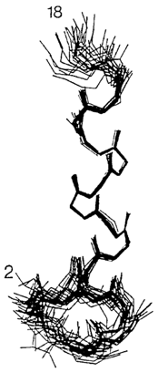
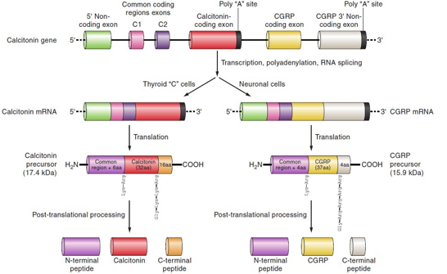
More about CGRP: Discovery and structure
CGRP was discovered in 1982-83 as an alternative transcript of the calcitonin gene
Structure of CGRP
The processing of the calcitonin CALC I gene leads to either calcitonin in the thyroid or α-CGRP in sensory neurons.
Rosenfeld MG et al. Nature 1983;304:129.; Amara SG et al. Nature 1982;298:240
Notes:
CGRP: Discovery and structure
CGRP was first discovered over 30 years ago, when it was realized that alternative
processing of the mRNA for calcitonin in the thyroid of the ageing rat leads to CGRP production.
The two forms of CGRP, α and βCGRP, are synthesized from two distinct genes at different sites on chromosome 11 in humans. The CALC I gene can undergo splicing to produce
either calcitonin or αCGRP; βCGRP is transcribed from the CALC II gene.
Reference
Russell FA et al. Calcitonin Gene-Related Peptide: physiology and pathophysiology. Physiol Rev 2013;94:1099.

Slide 4
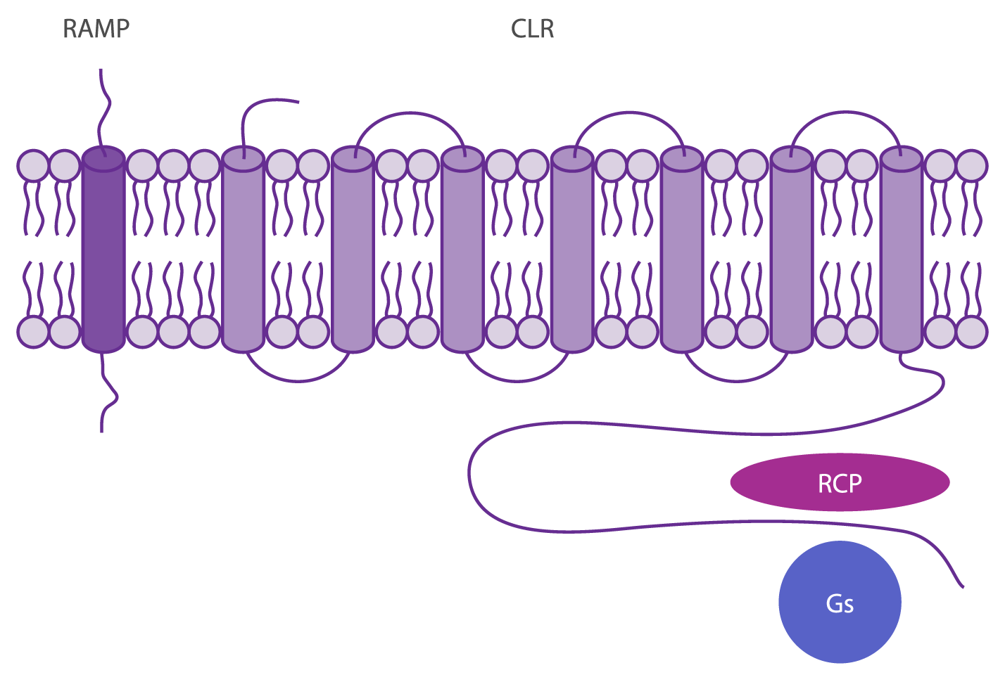
Where does CGRP bind?
CGRP binds to CGRP receptors, which are found throughout the body.
The CGRP receptor is a heterotrimer. It comprises of calcitonin-like receptor (CLR), a 7 transmembrane Gs protein- coupled structure, and the receptor activity-modifying protein (RAMP1).
The receptor component protein (RCP) is important for signaling.
Karsan N, Goadsby PJ. Curr Neurol Neurosci Rep 2015 15: 25.
Notes:
Where does CGRP bind?
CGRP binds with high affinity to the CGRP receptor, which is a heterotrimer, i.e. derived from two or more different (but similar) monomers. Specifically, the CGRP receptor complex consists of the calcitonin-like receptor (CLR), a 7 transmembrane Gs protein coupled structure, and the receptor activity-modifying protein (RAMP1). A small intracellular protein component, called receptor component protein (RCP), links the receptor to the intracellular signalling pathway.
Reference
Karsan N, Goadsby PJ. CGRP Mechanism Antagonists and Migraine Management. Curr Neurol Neurosci Rep 2015;15:25.

Slide 5
Where are CGRP and its receptors located?
CGRP is found in the central and peripheral nervous systems
CGRP and CGRP receptors are found in the intracranial blood vessel walls, trigeminal ganglion and dorsal root ganglion with central projections in the trigeminal nuclear complex, the most caudal part (at C1-C3 levels)
In the trigeminal nerve, CGRP is expressed in thin unmyelinated C-fibers, whereas CGRP receptors are expressed in thicker myelinated A-fibers
Edvinsson L. Headache 2015;55:1249.
Notes:
Where are CGRP and its receptors located?
CGRP and CGRP receptors are widely distributed throughout the central
and peripheral nervous system. The intracranial CGRP-containing fibers originate from the trigeminal ganglion. CGRP is released from the trigeminal ganglion cells
and dorsal root ganglion, key sites of neuropeptide synthesis. CGRP associates with sensory neurons, especially the unmyelinated C fibers and thinly myelinated A fibers,
CGRP is also localized in nonneuronal tissues, of which less is known at present.
References
Edvinsson L. The journey to establish CGRP as a migraine target: a retrospective view. Headache 2015;55:1249.
Karsan N, Goadsby PJ. CGRP Mechanism Antagonists and Migraine Management. Curr Neurol Neurosci Rep 2015;15:25.
Russell FA et al. Calcitonin Gene-Related Peptide: physiology and pathophysiology. Physiol Rev 2013;94:1099.

Slide 6
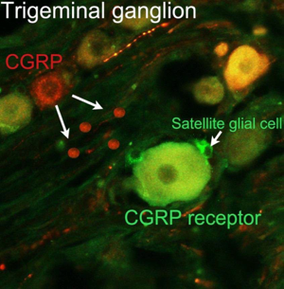
Where are CGRP and CGRP receptors in the trigeminal ganglion?
Immunofluorescence studies in rats and humans have identified the pattern of localization of CGRP and CGRP receptors in the trigeminal ganglia:
CGRP is expressed in small/medium-sized neurons
CGRP receptors are expressed in large- sized neurons and satellite glial cells. Satellite glial cells are thought to play an important role in inflammation and pain.
Courtesy of Lars Edvinsson
Notes:
Where are CGRP and CGRP receptors in the trigeminal ganglion?
The binding of CGRP and CGRP receptors in the trigeminal ganglion has attracted interest given that the trigeminovascular system is involved in the regulation of the
the cranial blood vessels and plays a role in pain transmission.
Experimental immunofluorescence studies of CGRP binding in the trigeminal ganglion in rats and humans has shown that CGRP is predominantly expressed in small or medium sized neurons, as well as very thin unmyelinated nerve fibers.
In contrast, CGRP receptor components are expressed mainly in larger neurons and in satellite glial cells; the latter are thought to play an important role in inflammation and pain.
References
Eftekhari S et al. Localization of CGRP, CGRPreceptor, PACAP and glutamate in trigeminal ganglion. Relation to the blood–brain barrier. Brain Res 2015;1600:93.
Eftekhari S, Edvinsson L. Possible sites of action of the new calcitonin gene related peptide receptor antagonists. Ther Adv Neurol Disord 2010;3:369.
Raddant AC, Russo AF. Calcitonin gene-related peptide in migraine: intersection of peripheral inflammation and central modulation.Expert Rev Mol Med 2011;13:e36.

Slide 7
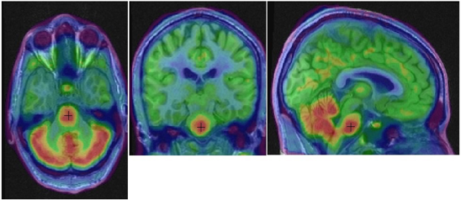
CGRP receptors in the human brain: A link with migraine
Baseline Receptor Visualization Studies using [11C]MK-4232 Slide courtesy of Lars Edvinsson and Richard Hargreaves
Notes:
CGRP receptors in the human brain: a link with migraine
A landmark study in 1990 provided the first clear evidence that CGRP is released into the extracerebral circulation, without any change in the levels of other neuropeptides such as substance P, vasoactive intestinal polypeptide (a marker of parasympathetic nerve activity), or neuropeptide Y NPY (a marker of sympathetic nerve activity). These findings provided a rationale for considering CGRP as a potential strategy to treat migraine.
Reference
Goadsby PJ et al. Vasoactive peptide release in the extracerebral circulation of humans during migraine headache. Ann Neurol 1990;28:183.

Slide 8
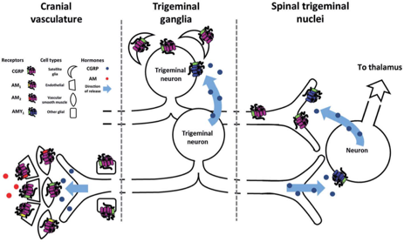
CGRP and the trigeminovascular system
In the trigeminocervical complex (TCC), CGRP acts on second-order neurons to activate spinothalamic pathways
Walker CS and Hay DL. Brit J Pharmacol 2013;170 :1293–1307
Notes:
CGRP and the trigeminovascular system
The trigeminovascular system is involved in the regulation of the cranial blood vessels and plays a key role in the transmission of pain.
CGRP receptors are widely distributed in the trigeminovascular system, which suggests that this neuropeptide may play a role in migraine pathophysiology. This schematic figure gives an overview of potential CGRP and CGRP-responsive receptor expression in this system. Studies have shown that CGRP is synthesized and released from the trigeminal ganglia neurons that innervate the cranial blood vessels. CGRP also acts as a neurotransmitter in the trigeminal ganglion and second-order neurons in the trigeminal nucleus caudalis to facilitate transmission of pain.
Reference
Walker CS, Hay DL. CGRP in the trigeminovascular system: a role for CGRP, adrenomedullin and amylin receptors? Brit J Pharmcol 2013;170 :1293.

Slide 9
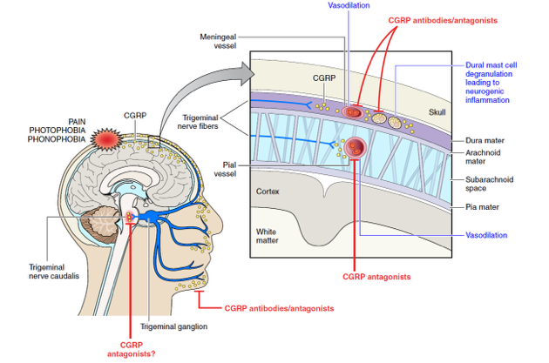
CGRP plays a pivotal role in migraine
Russell FA et al. Physiol Rev 2014;94:1099.
Notes:
CGRP plays a pivotal role in migraine
Pain during a migraine attack is linked to the release of CGRP. Studies show that CGRP levels increase during an acute migraine, and decrease during effective treatment of an attack. Additionally, infusion of CGRP has been shown to trigger a migraine in migraine sufferers. The available evidence suggests that the trigeminal ganglion is an important site of action for CGRP in transmitting pain signals to the thalamus and higher cortical pain regions.
Taken together, these lines of evidence support a role for CGRP in migraine neurobiology, and thus as a potential therapeutic target.
References
Goadsby PJ et al. Vasoactive peptide release in the extracerebral circulation of humans during migraine headache. Ann Neurol 1990;28:183.
Hansen JM et al. Calcitonin gene-related peptide triggers migraine-like attacks in patients with migraine with aura. Cephalalgia 2010;30,1179.
Russell FA et al. Calcitonin Gene-Related Peptide: physiology and pathophysiology. Physiol Rev 2013;94:1099.

Slide 10
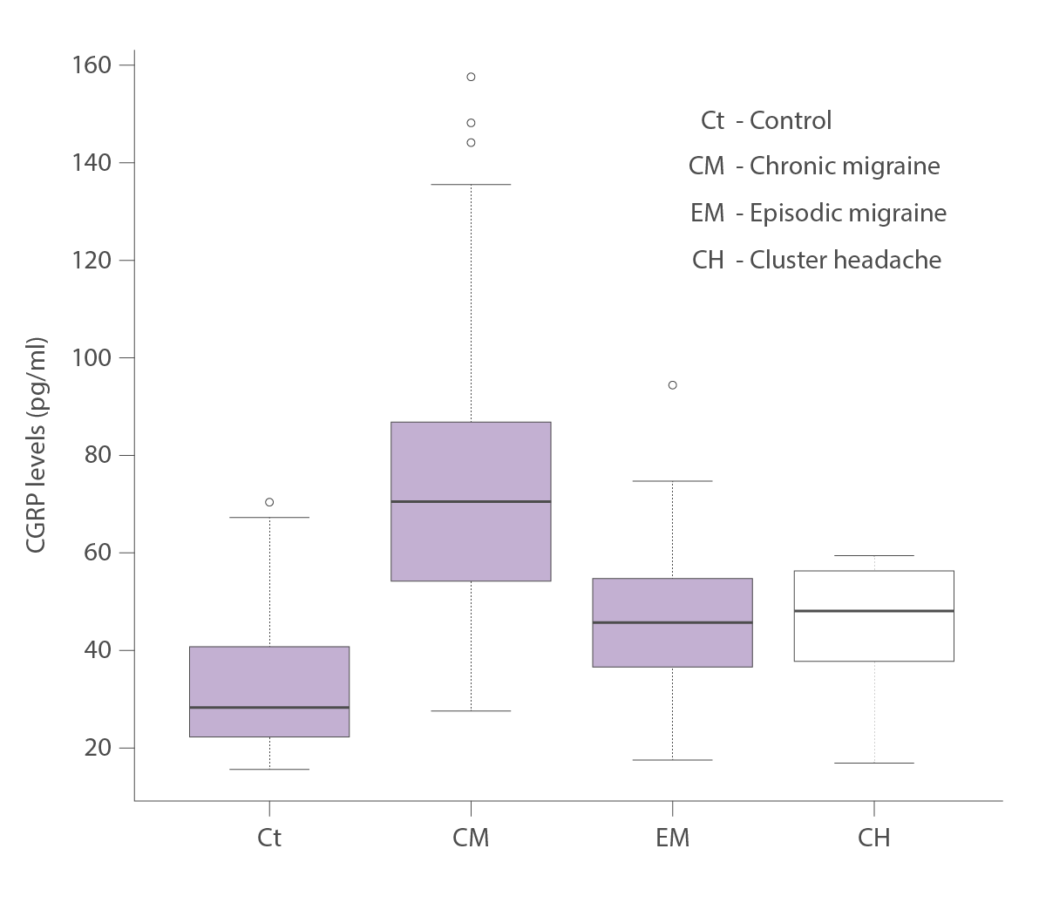
CGRP levels are increased in migraine sufferers
Peripheral blood CGRP levels were significantly higher in women with a history of chronic or episodic migraine, outside of migraine attacks, than in controls
Cernuda-Morollón E et al. Neurology 2013;81:1191.
Notes:
CGRP levels are increased in migraine sufferers
This study measured peripheral blood levels of CGRP outside migraine attacks in 103 women with chronic migraine, 31 matched controls, 43 with episodic migraine, and 14 with episodic cluster headache matched for age. CGRP levels were significantly higher in those with chronic migraine than controls (74.90 pg/mL versus 33.74 pg/mL), as well as episodic migraine (46.37 pg/mL), or episodic cluster headache (45.87 pg/mL). This suggests that increased CGRP levels may represent a biomarker to aid in diagnosis of migraine.
Reference
Cernuda-Morollón E. Interictal increase of CGRP levels in peripheral blood as a biomarker for chronic migraine. Neurology 2013;81:1191.

Slide 11
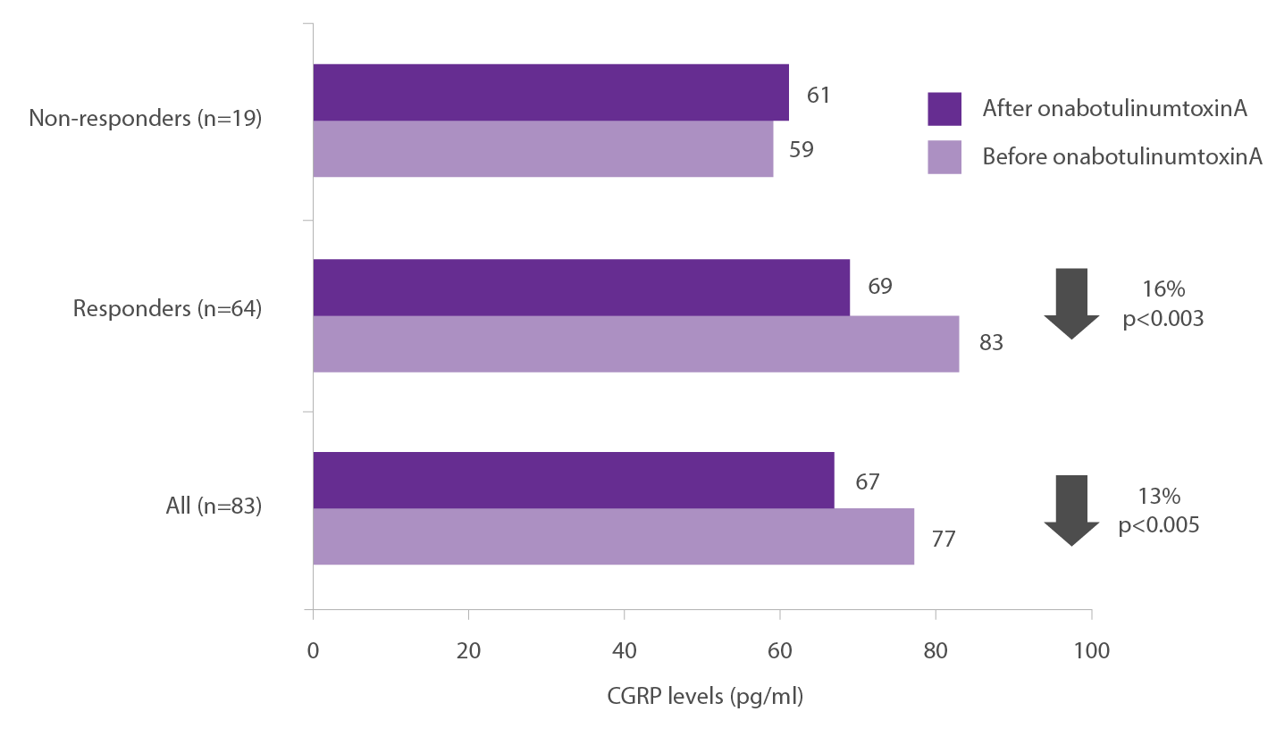
CGRP levels: A predictor of treatment response in chronic migraine
In subjects with chronic migraine, CGRP levels after onabotulinumtoxinA treatment were significantly lower than levels found before treatment
Notably, CGRP levels in responders were significantly higher than those seen in non-responders to onabotulinumtoxinA treatment
Cernuda-Morollón E et al. Pain 2015;156:820.
Notes:
CGRP levels: a predictor of treatment response in chronic migraine
OnabotulinumtoxinA has been shown to have efficacy in the management of chronic migraine. In this study in 83 patients with chronic migraine (mean age 44 years; 94% females), interictal plasma CGRP levels were measured before and 1 month after treatment with onabotulinumtoxinA. In all patients, median CGRP plasma levels were lower after treatment (51.9 versus 74.1 pg/ml, p<0.001). In particular, pretreatment plasma levels of CGRP were significantly higher in responders than nonresponders (76.9 versus 50.5 pg/ml, p=0.001). These findings suggest that plasma CGRP levels may be a predictor of response to this migraine treatment.
Reference
Cernuda-Morollón E et al. OnabotulinumtoxinA decreases interictal CGRP plasma levels in patients with chronic migraine. Pain 2015;156:820.

Slide 12
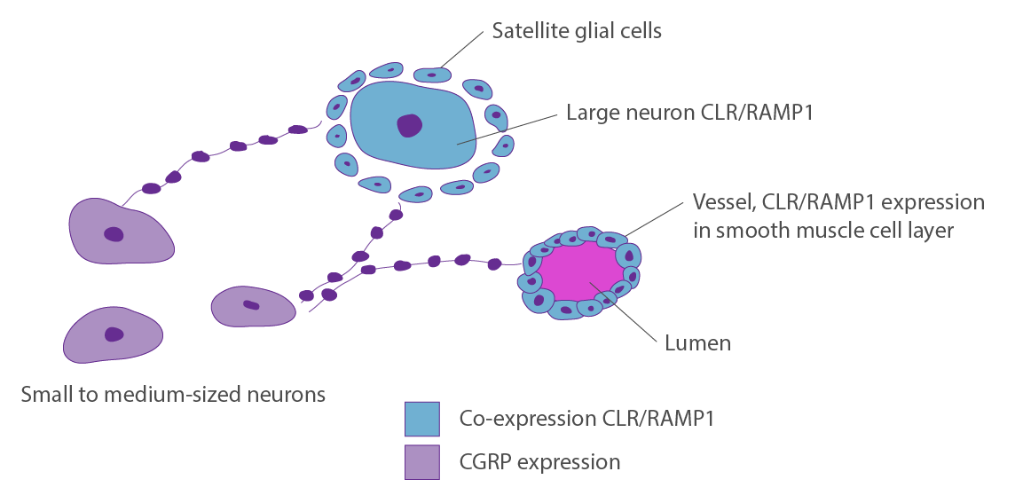
Do CGRP-targeted agents need to cross the blood-brain barrier?
The trigeminal ganglion is a key site of action for CGRP in migraine
CGRP and CGRP receptors are expressed in the trigeminal ganglion. As the trigeminal ganglion is expressed outside the blood-brain barrier (BBB), therapeutic agents do not need to penetrate the BBB to act.
Eftekhari S et al. Brain Res 2015; 1600:93.
Notes:
The trigeminal ganglion has been identified as a key site of action for CGRP in migraine. This poses a key question: where is this located with respect to the blood brain barrier? Administration of Evans Blue (a dye which binds to serum albumin and cannot therefore cross the blood brain barrier), in rats showed that the dye was taken up by the trigeminal ganglion. This shows that the trigeminal ganglion is located outside the blood brain barrier, and that it is therefore not necessary for agents targeting CGRP to cross the blood brain barrier.
Reference
Eftekhari S et al. Localization of CGRP, CGRP receptor, PACAP and glutamate in trigeminal ganglion. Relation to the blood-brain barrier. Brain Res 2015; 1600:93.
Do CGRP-targeted agents need to cross the blood brain barrier?

Slide 13
CGRP inhibition: Potential for prevention of migraine
The most important evidence for the role of CGRP in migraine pain was provided by studies with CGRP receptor antagonists.
In a proof-of-concept study, the CGRP receptor antagonist olcegepant was shown to be effective in treating migraine
However, because these agents had a number of issues, including liver toxicity, new approaches that target CGRP or its receptor are needed.
Notes:
CGRP inhibition: potential for prevention of migraine
In a proof of concept study, the CGRP receptor antagonist olcegepant was shown to be effective in treating migraine. However, as this agent could only be administered intravenously, development was terminated. Other CGRP receptor antagonists were effective in acute migraine but had issues with liver toxicity (telcagepant, MK-3207); development has not continued for undisclosed reasons with other agents (rimegepant, BI 44370 TA, MK-1602). There is no ongoing development of other CGRP-receptor antagonists.
These studies provide important support for the role of CGRP in migraine pain. However, new approaches targeting CGRP or tis receptor are needed.
References
Doods H, Hallermayer G, Wu D, et al. Pharmacological profile of BIBN4096BS, the first selective small molecule CGRP antagonist. Br J Pharmacol 2000;129:420.
Ho TW, Connor KM, Zhang Y, et al. Randomized controlled trial of the CGRP receptor antagonist telcagepant for migraine prevention. Neurology 2014;83:958.
Hewitt DJ, Aurora SK, Dodick DW, et al. Randomized controlled trial of the CGRP receptor antagonist MK-3207 in the acute treatment of migraine. Cephalalgia 2011;31:712.
Diener HC, Barbanti P, Dahlöf C et al. BI 44370 TA, an oral CGRP antagonist for the treatment of acute migraine attacks: results from a phase II study. Cephalalgia 2011;31:573.
Peroutka SJ. Clinical trials update. 2013: year in review. Headache 2014;54:189.

