Slide 1


*Calcitonin gene-related peptide
A background
To cgrp* and its receptor

Slide 2
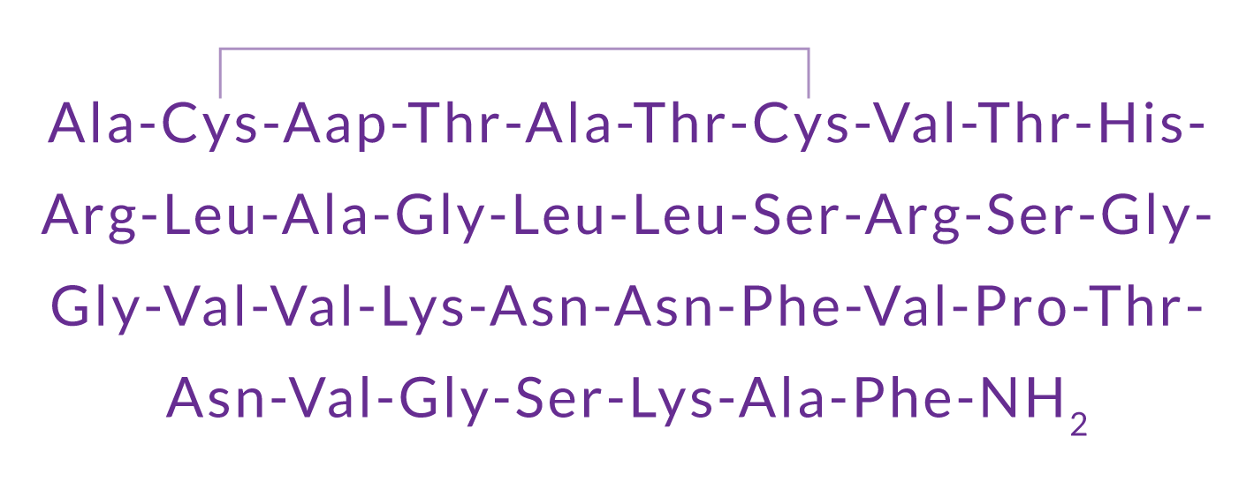


What is Calcitonin Gene-Related Peptide (CGRP)?
CGRP is a 37-amino acid neuropeptide derived from the gene encoding calcitonin.
It is a potent vasodilator and also functions as a messenger in nerve cells.
CGRP exists in two forms in humans
α-CGRP is the predominant form
Found in the peripheral and central nervous systems.
Formed from alternative splicing of the calcitonin/CGRP gene on chromosome 11.
β-CGRP is found in the enteric nervous system. This differs in 3 amino acids.
Amara SG et al. Nature 1982;298:240
Notes:
What is Calcitonin Gene-Related Peptide (CGRP)?
CGRP is a 37 amino acid neuropeptide, derived from the gene encoding calcitonin. It exists as two isoforms; α-CGRP in the peripheral and central nervous systems and β-CGRP mainly in the enteric nervous system. α-CGRP is the predominant form.
In the periphery, CGRP mediates vasodilatation whereas centrally, it mediates the transmission of pain and is also involved in regulatory mechanisms (the latter in the brainstem).
CGRP belongs to the calcitonin family of peptides that also includes adrenomedullin, calcitonin, and
amylin, all of which have important physiologic functions.
References
Russell FA et al. Calcitonin Gene-Related Peptide: physiology and pathophysiology. Physiol Rev 2013;94:1099.

Slide 3
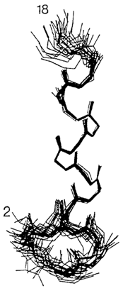
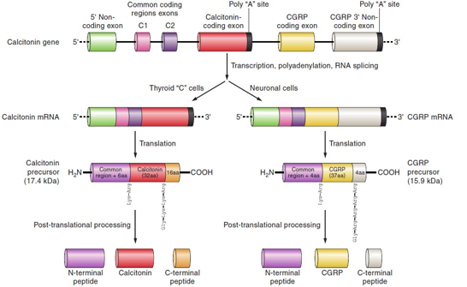
More about CGRP: Discovery and structure
CGRP was discovered in 1982-83 as an alternative transcript of the calcitonin gene
Structure of CGRP
The processing of the calcitonin CALC I gene leads to either calcitonin in the thyroid or α-CGRP in sensory neurons.
Rosenfeld MG et al. Nature 1983;304:129.; Amara SG et al. Nature 1982;298:240
Notes:
CGRP: Discovery and structure
CGRP was first discovered over 30 years ago, when it was realized that alternative
processing of the mRNA for calcitonin in the thyroid of the ageing rat leads to CGRP production.
The two forms of CGRP, α and βCGRP, are synthesized from two distinct genes at different sites on chromosome 11 in humans. The CALC I gene can undergo splicing to produce
either calcitonin or αCGRP; βCGRP is transcribed from the CALC II gene.
Reference
Russell FA et al. Calcitonin Gene-Related Peptide: physiology and pathophysiology. Physiol Rev 2013;94:1099.

Slide 4
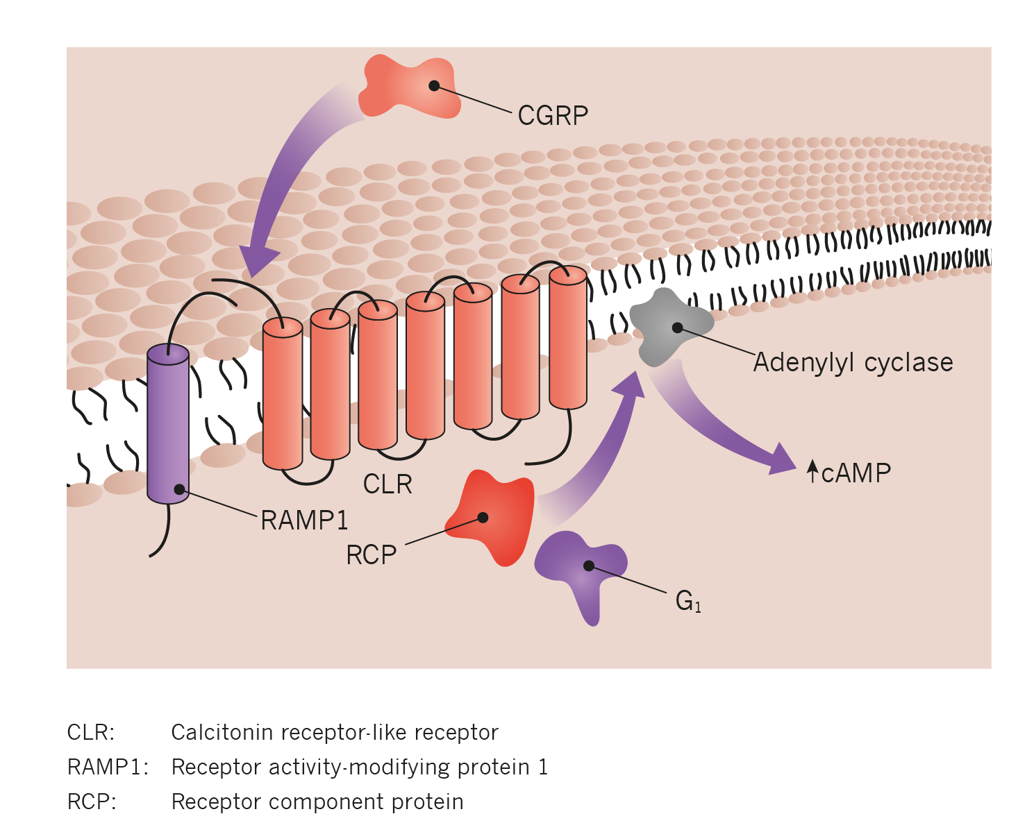
Where does CGRP bind?
CGRP binds to CGRP receptors, which are found throughout the body.
The CGRP receptor is a heterotrimer comprised of:
Calcitonin-like receptor (CLR), a seven transmembrane Gs protein coupled structure, and
Receptor activity-modifying protein 1 (RAMP1).
When CLR is localized with RAMP2 or RAMP2, the receptor is activated by adrenomedullin.
The receptor component protein (RCP) is important for signaling. This links the receptor to the intracellular signalling pathway, which works through G proteins and adenylyl cyclase, causing raised cAMP levels.
Karsan N, Goadsby PJ. Curr Neurol Neurosci Rep 2015 15: 25.
Notes:
Where does CGRP bind?
CGRP binds with high affinity to the CGRP receptor, which is a heterotrimer, i.e. derived from two or more different (but similar) monomers. Specifically, the CGRP receptor complex consists of the calcitonin-like receptor (CLR), a 7 transmembrane Gs protein coupled structure, and the receptor activity-modifying protein (RAMP1). A small intracellular protein component, called receptor component protein (RCP), links the receptor to the intracellular signalling pathway.
Reference
Karsan N, Goadsby PJ. CGRP Mechanism Antagonists and Migraine Management. Curr Neurol Neurosci Rep 2015;15:25.

Slide 5
Where are CGRP and its receptors located?
CGRP and CGRP receptors are widely expressed in the central nervous system (CNS) and throughout the trigeminovascular system. Binding studies showed:
- Co-expression of CLR and RAMP-1 in smooth muscle of human cranial vessels
CGRP and CGRP receptor expression in the dura mater and the trigeminal ganglion
In the spinal cord, CGRP expression in un-myelinated fibres (C-fibres); CGRP receptor expression in myelinated fibres (A-fibres)
In primates, CGRP and CGRP receptors were expressed in the cerebellum, and CGRP receptors also in the brainstem
CONTROL
In the human dura, labelling with the CGRP receptor antibodies AA32 highlighted staining in the inner vascular smooth muscle layer (thick arrow, lower inset).
However, staining of the endothelial cells (arrowhead, upper inset) is the same as in the control
CGRP RECEPTOR ANTIBODY
Miller S et al. Neuroscience 2016;328:165–183
Notes:
Where are CGRP and its receptors located?
Immunohistochemical staining with recently developed CRP receptor antibodies specifically recognizing a fusion protein of the extracellular domains of RAMP1 and CLR that comprise
the CGRP binding pocket at the CGRP receptor in monkey and man have been used to map CGRP receptor localisation.
CGRP receptors were shown to be localised in human vascular smooth muscle cells of dural
meningeal arteries and neurons in the trigeminal ganglion, as well neurons and satellite glial cells in the trigeminal ganglion, and in neurons in the spinal trigeminal nucleus caudalis.
Reference
Miller S et al. Immunohistochemical localization of the calcitonin gene-related peptide binding site in the primate trigeminovascular system using functional antagonists antibodies. Neuroscience 2016;328:165–183

Slide 6
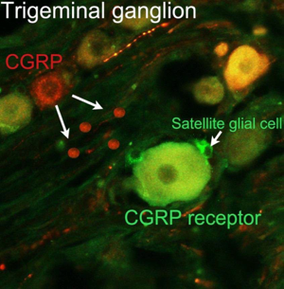
Where are CGRP and CGRP receptors in the trigeminal ganglion?
Immunofluorescence studies in rats, primates and humans have identified the pattern of localization of CGRP and CGRP receptors in the trigeminal ganglion.
CGRP is expressed in small/medium-sized neurons
CGRP receptors are expressed in large- sized neurons and satellite glial cells. Satellite glial cells are thought to play an important role in inflammation and pain.
Binding studies using functional CGRP receptor antagonist antibodies has shown CGRP receptor localization consistent with a role for CGRP receptors in trigeminal sensitization and migraine pathology
Courtesy of Lars Edvinsson
Notes:
Where are CGRP and CGRP receptors in the trigeminal ganglion?
The binding of CGRP and CGRP receptors in the trigeminal ganglion has attracted interest given that the trigeminovascular system is involved in the regulation of the
the cranial blood vessels and plays a role in pain transmission.
Experimental immunofluorescence studies of CGRP binding in the trigeminal ganglion in rats and humans has shown that CGRP is predominantly expressed in small or medium sized neurons, as well as very thin unmyelinated nerve fibers.
In contrast, CGRP receptor components are expressed mainly in larger neurons and in satellite glial cells; the latter are thought to play an important role in inflammation and pain.
References
Eftekhari S et al. Localization of CGRP, CGRPreceptor, PACAP and glutamate in trigeminal ganglion. Relation to the blood–brain barrier. Brain Res 2015;1600:93.
Eftekhari S, Edvinsson L. Possible sites of action of the new calcitonin gene related peptide receptor antagonists. Ther Adv Neurol Disord 2010;3:369.
Raddant AC, Russo AF. Calcitonin gene-related peptide in migraine: intersection of peripheral inflammation and central modulation.Expert Rev Mol Med 2011;13:e36.

Slide 7
CGRP: A ROLE IN MIGRAINE?

Slide 8
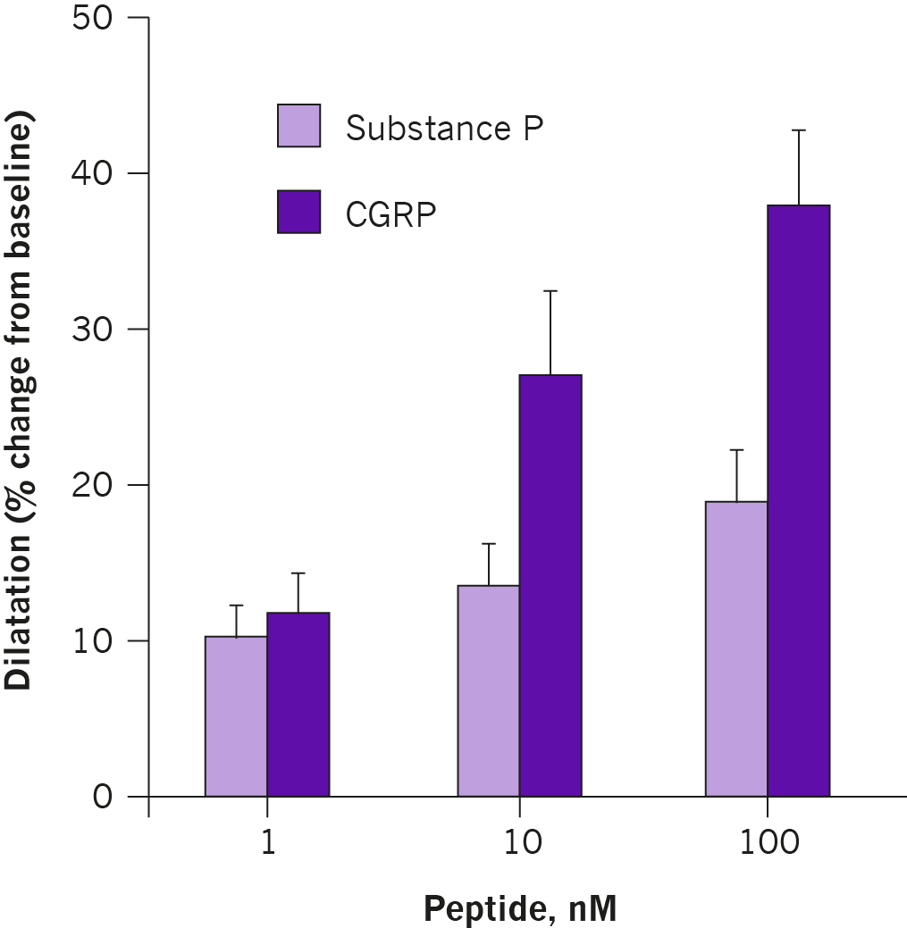
CGRP is a potent vasodilator of cerebral arteries
CGRP was previously established as a potent dilator of blood vessels in peripheral vascular beds.
In this in vitro study, CGRP was also significantly more potent than substance P as a vasodilator of cerebral vessels.
McCulloch J et al. Proc Natl Acad Sci U S A 1986;83:5731-5.
Notes:
CGRP is a potent vasodilator of cerebral arteries
In early studies, nerve fibres containing CGRP-immunoreactivity were demonstrated around cerebral blood vessels. The origin of these nerve fibres was thought to be the trigeminal ganglion. In vitro studies showed that while CGRP was colocalized with substance P in neurons in the trigeminal ganglia, CGRP was a significantly more potent dilator of cerebral blood vessels than substance P.
Reference
McCulloch J et al. Calcitonin gene-related peptide: functional role in cerebrovascular regulation. Proc Natl Acad Sci U S A 1986;83:5731-5.

Slide 9
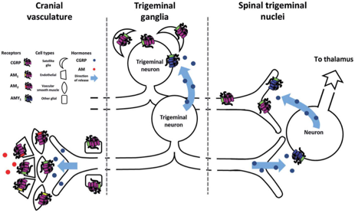
CGRP and the trigeminovascular system
In the trigeminocervical complex, CGRP acts on second-order neurons to activate spinothalamic pathways
Walker CS and Hay DL. Brit J Pharmacol 2013;170 :1293–1307
Notes:
CGRP and the trigeminovascular system
The trigeminovascular system is involved in the regulation of the cranial blood vessels and plays a key role in the transmission of pain.
CGRP receptors are widely distributed in the trigeminovascular system, which suggests that this neuropeptide may play a role in migraine pathophysiology. This schematic figure gives an overview of potential CGRP and CGRP-responsive receptor expression in this system. Studies have shown that CGRP is synthesized and released from the trigeminal ganglia neurons that innervate the cranial blood vessels. CGRP also acts as a neurotransmitter in the trigeminal ganglion and second-order neurons in the trigeminal nucleus caudalis to facilitate transmission of pain.
Reference
Walker CS, Hay DL. CGRP in the trigeminovascular system: a role for CGRP, adrenomedullin and amylin receptors? Brit J Pharmcol 2013;170 :1293.

Slide 10
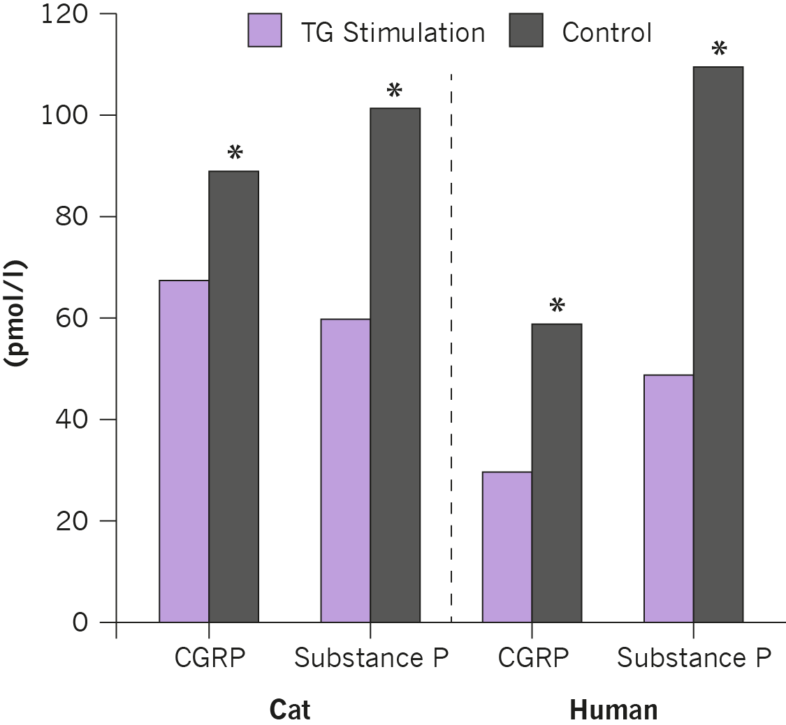
Trigeminal ganglion stimulation increases CGRP in the cranial circulation
Electrical stimulation of the trigeminal ganglion increased levels of substance P-like and CGRP-like immunoreactivity.
These findings suggested a putative role of these peptides in the pathophysiology of migraine.
Goadsby PJ et al. Ann Neurol 1988;23:193-6.
Notes:
Trigeminal ganglion stimulation increases CGRP in the cranial circulation
Activation of the trigeminal ganglion by electrical stimulation led to an increase in levels of CGRP in the extracerebral circulation, as well as Substance P, suggesting a putative role in migraine.
Reference
Goadsby PJ et al. Vasoactive peptide release in the extracerebral circulation of humans during migraine headache. Ann Neurol 1990;28:183-7.

Slide 11
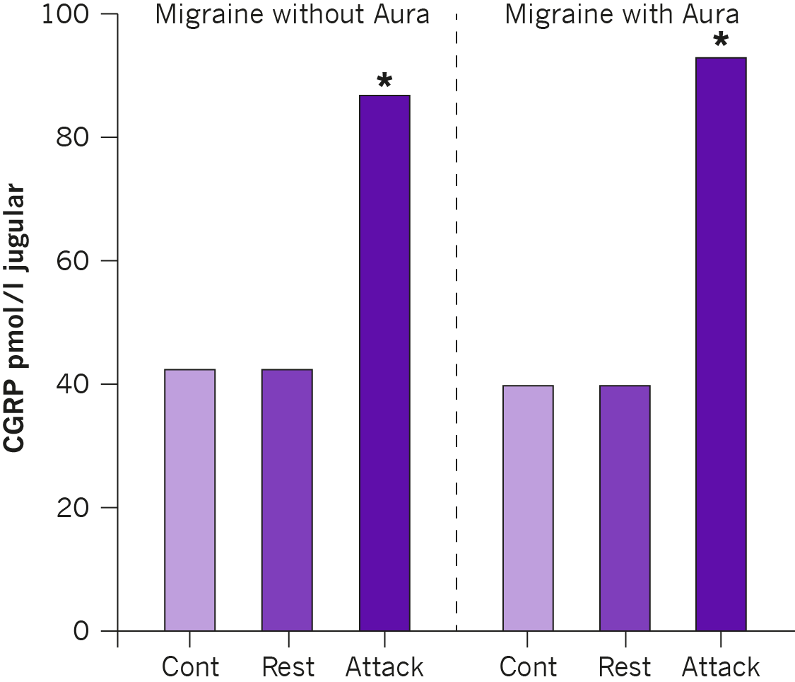
CGRP levels are increased in migraine sufferers
During migraine attacks (with or without aura) CGRP levels increase in the extracerebral circulation (external jugular blood)
Only CGRP levels are elevated; there is no change in other peptides thought to be involved in pain transmission
Goadsby PJ et al. Ann Neurol 1990;28:183-7.
Notes:
CGRP levels are increased during a migraine attack
Local release of neuropeptide vasodilator substances into the extracerebral circulation was studied in patients with migraine. During a migraine attack there was an increase in calcitonin gene-related peptide (CGRP) levels in the external jugular but not the cubital fossa blood. There was no change in other neuropeptide vasodilator substances.
Reference
Goadsby PJ et al. Vasoactive peptide release in the extracerebral circulation of humans during migraine headache. Ann Neurol 1990;28:183-7.

Slide 12
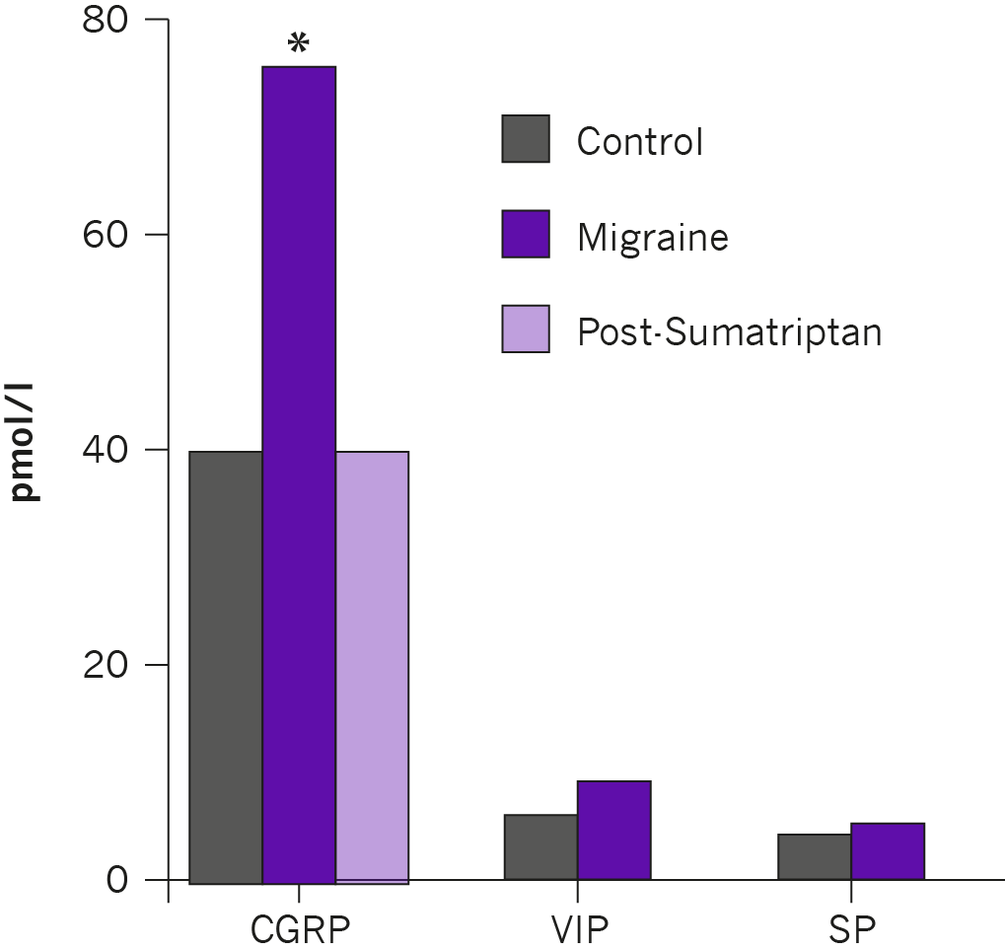
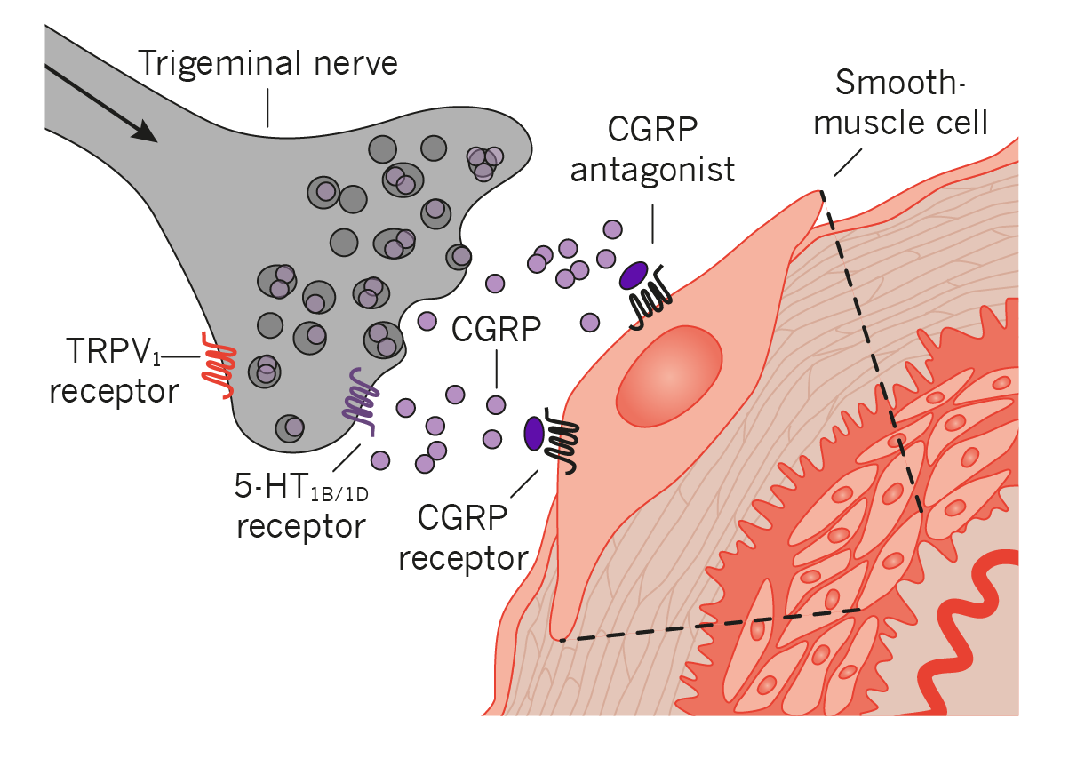
Triptans suppress CGRP release from trigeminal nerves
Sumatriptan acts via presynaptic 5-HT1B/D receptors to suppress CGRP release from trigeminal nerves
Treatment with sumatriptan normalized the increase in CGRP levels seen in acute migraine, with relief of headache pain
Goadsby PJ et al. Ann Neurol 1993;33:48-56
Notes:
Triptans suppress CGRP release from trigeminal nerves
First introduced in the 1990s, triptans (serotonin 5-hydroxytryptamine (5-HT)(1B/1D) agonists) are used to treat acute migraine, Mechanistic studies have shown that these agents act by binding to serotonin receptors in the brain, leading to a reversal of blood vessel swelling and suppression of CGRP release from trigeminal nerves. In acute migraine, triptan treatment normalized elevated CGRP levels seen in controls, and also alleviated migraine pain.
Reference
Goadsby PJ, Edvinsson L. et al. The trigeminovascular system and migraine: studies characterizing cerebrovascular and neuropeptide changes seen in humans and cats. Ann Neurol 1993;33:48-56.

Slide 13
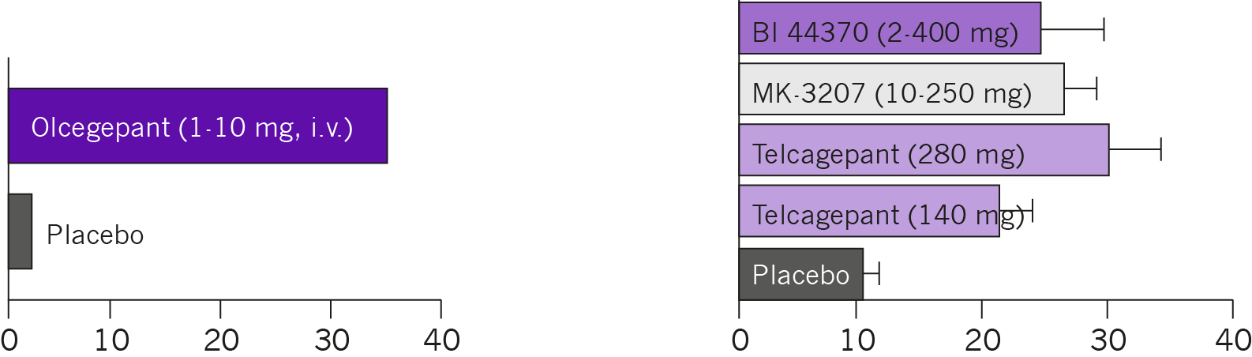
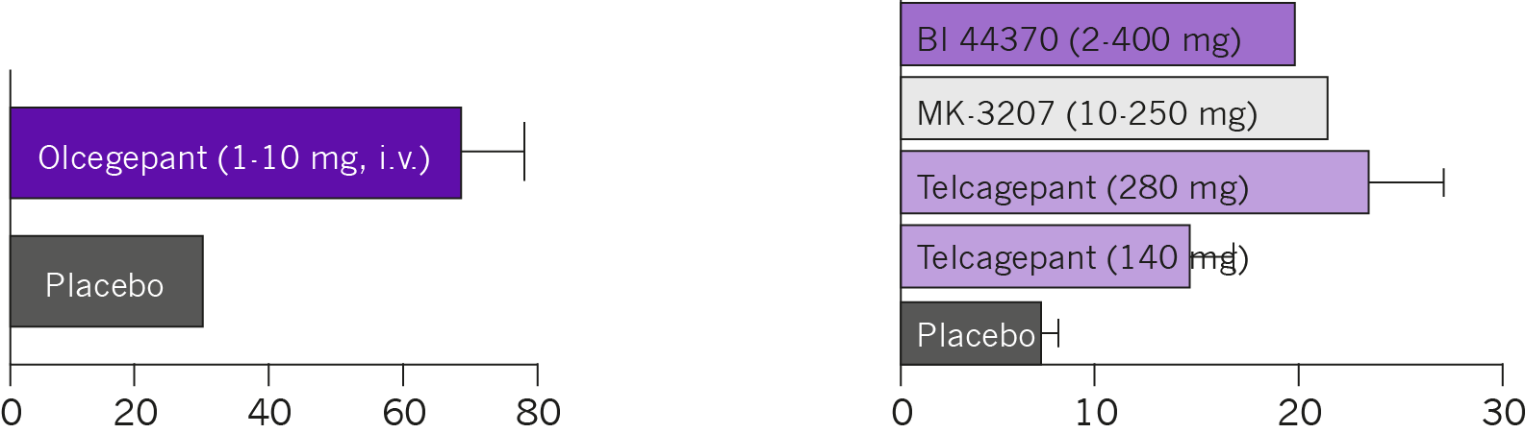
Acute treatment with CGRP receptor blockers provides relief of migraine headache
Pain free at 2 hrs (% Patients)
Olcegepant, the first potent and selective non-peptide antagonist of the CGRP receptor, was shown to be effective in treating acute migraine
However, as some of agents had a number of issues, including liver toxicity, new approaches that target CGRP or its receptor are needed.
Sustained Pain free at 24 hrs(% Patients)
Edvinsson L, Linde M. Lancet 2010;376:645-55. Olesen J et al. N Engl J Med 2004;350:1104-10.
Notes:
CGRP inhibition: potential for prevention of migraine
Olcegepant, the first potent and selective non-peptide antagonist of the CGRP receptor was shown to be effective in treating migraine, significantly reducing both the pain-free rate at 2 hours and the rate of sustained response over a period of 24 hours. However, as this agent could only be administered intravenously, development was terminated.
Other CGRP receptor antagonists were also effective in acute migraine but had issues with liver toxicity (telcagepant, MK-3207); development has not continued for undisclosed reasons with other agents (rimegepant, BI 44370 TA, MK-1602).
These studies provide important support for the role of CGRP in migraine pain. However, new approaches targeting CGRP or tis receptor are needed.
References
Olesen J et al. Calcitonin gene-related peptide receptor antagonist BIBN 4096 BS for the acute treatment of migraine. N Engl J Med 2004;350:1104-10.
Edvinsson L, Linde M. New drugs in migraine treatment and prophylaxis: telcagepant and topiramate. Lancet 2010;376:645-55.
Ho TW, Connor KM, Zhang Y, et al. Randomized controlled trial of the CGRP receptor antagonist telcagepant for migraine prevention. Neurology 2014;83:958.
Hewitt DJ, Aurora SK, Dodick DW, et al. Randomized controlled trial of the CGRP receptor antagonist MK-3207 in the acute treatment of migraine. Cephalalgia 2011;31:712.
Diener HC, Barbanti P, Dahlöf C et al. BI 44370 TA, an oral CGRP antagonist for the treatment of acute migraine attacks: results from a phase II study. Cephalalgia 2011;31:573.
Peroutka SJ. Clinical trials update. 2013: year in review. Headache 2014;54:189.

Slide 14
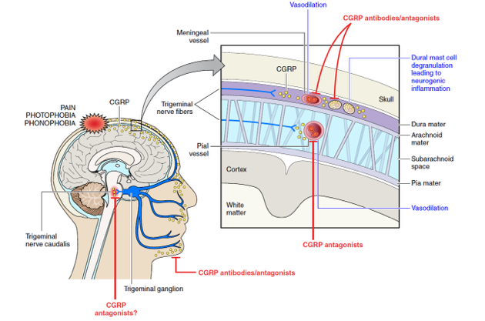
CGRP plays a pivotal role in migraine
Note: CGRP antagonists refers to small molecule antagonists
Russell FA et al. Physiol Rev 2014;94:1099.
Notes:
CGRP plays a pivotal role in migraine
Pain during a migraine attack is linked to the release of CGRP. Studies show that CGRP levels increase during an acute migraine, and decrease during effective treatment of an attack. Additionally, infusion of CGRP has been shown to trigger a migraine in migraine sufferers. The available evidence suggests that the trigeminal ganglion is an important site of action for CGRP in transmitting pain signals to the thalamus and higher cortical pain regions.
Taken together, these lines of evidence support a role for CGRP in migraine neurobiology, and thus as a potential therapeutic target.
References
Goadsby PJ et al. Vasoactive peptide release in the extracerebral circulation of humans during migraine headache. Ann Neurol 1990;28:183.
Hansen JM et al. Calcitonin gene-related peptide triggers migraine-like attacks in patients with migraine with aura. Cephalalgia 2010;30,1179.
Russell FA et al. Calcitonin Gene-Related Peptide: physiology and pathophysiology. Physiol Rev 2013;94:1099.

Slide 15
PROPOSED SITE OF ACTION OF MIGRAINE THERAPIES

Slide 16
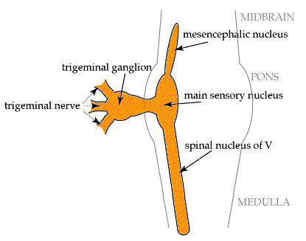
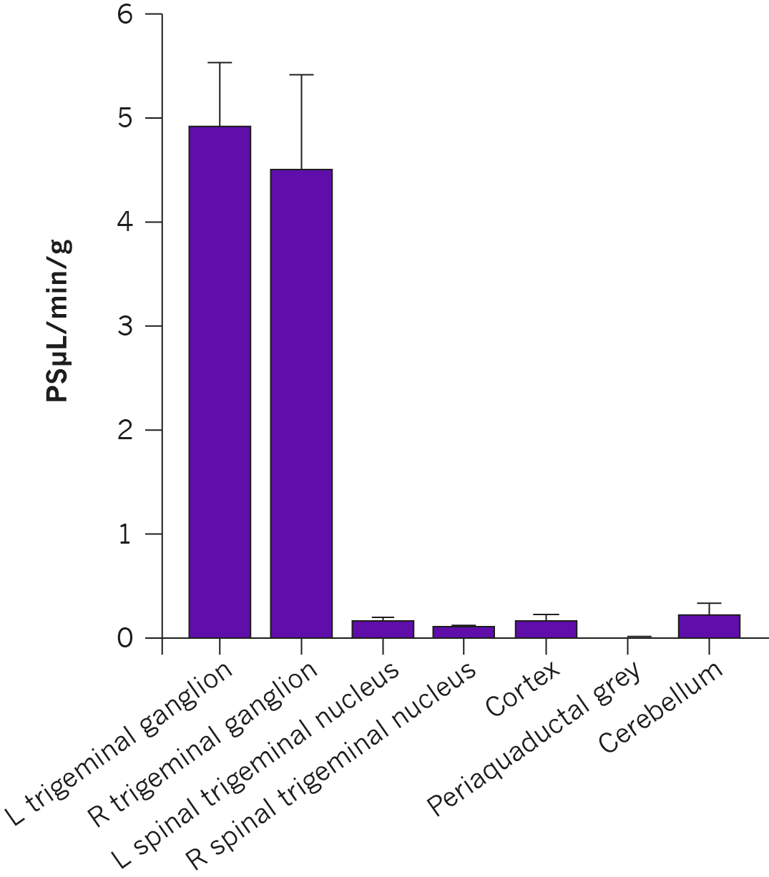
Do CGRP-targeted agents need to cross the blood-brain barrier?
Permeability of Evans Blue dye was >30 times higher in the trigeminal ganglion than in any brain region
The trigeminal ganglion is a key site of action for CGRP in migraine but is not protected by the blood brain barrier.
Use of Evans Blue dye (which binds to albumin) shows that CGRP-targeted agents do not need to cross the intact blood brain barrier for efficacy
.
Notes:
The trigeminal ganglion has been identified as a key site of action for CGRP in migraine. This poses a key question: where is this located with respect to the blood brain barrier? Administration of Evans Blue (a dye which binds to serum albumin and cannot therefore cross the blood brain barrier), in rats showed that the dye was taken up by the trigeminal ganglion. This shows that the trigeminal ganglion is located outside the blood brain barrier, and that it is therefore not necessary for agents targeting CGRP to cross the blood brain barrier.
Reference
Eftekhari S et al. Localization of CGRP, CGRP receptor, PACAP and glutamate in trigeminal ganglion. Relation to the blood-brain barrier. Brain Res 2015; 1600:93.
Do CGRP-targeted agents need to cross the blood brain barrier?

Slide 17
Do CGRP-targeted agents need to cross the blood-brain barrier?
No. The trigeminal ganglion is readily exposed to circulating molecules and could provide a site for anti-migraine drug interaction with CGRP elements of the trigeminovascular system.
In addition, inflammatory mediators do not influence the permeability of the blood brain barrier.
Edvinsson L. Br J Clin Pharmacol 2015;80:193-9
Notes:
The trigeminal ganglion has been identified as a key site of action for CGRP in migraine. This poses a key question: where is this located with respect to the blood brain barrier? Administration of Evans Blue (a dye which binds to serum albumin and cannot therefore cross the blood brain barrier), in rats showed that the dye was taken up by the trigeminal ganglion. This shows that the trigeminal ganglion is located outside the blood brain barrier, and that it is therefore not necessary for agents targeting CGRP to cross the blood brain barrier.
Reference
Eftekhari S et al. Localization of CGRP, CGRP receptor, PACAP and glutamate in trigeminal ganglion. Relation to the blood-brain barrier. Brain Res 2015; 1600:93.
Do CGRP-targeted agents need to cross the blood brain barrier?

Slide 18

CGRP and CGRP receptor antagonists do not act centrally for clinical effect
Telcagepant has low receptor occupancy in the CNS at clinically effective doses in both healthy subjects and migraine patients
While a higher does of telcagepant displaces the tracer from the CGRP receptor, there is no additional clinical benefit
Baseline
Positron emission tomography (PET) of the human brain showing uptake of the CGRP PET CNS tracer [11C]MK-4232 at baseline and after administration of telcagepant, a potent, selective CGRP-receptor antagonist 140 mg, 1120 mg
Telcagepant 140 and 1120 mg
Hostetler ED et al. J Pharmacol Exp Ther 2013;347:478-86
Notes:
CGRP and CGRP receptor antagonists do not act centrally for clinical effect
CGRP receptors are expressed in the central nervous system(CNS). Additionally, CGRP levels in
the cranial circulation increase during a migraine attack and CGRP itself has been shown to trigger migraine headache. However, there has been debate whether antagonism of CGRP receptors in the CNS is relevant for efficacy.
In this study in human healthy volunteers, there was only significant CGRP receptor occupancy in the brain after a dose of telcagepant that was 8-fold higher than that used in phase III trials (4-10% receptor occupancy with 140 mg versus 43-58% with 1120 mg). This suggests that inhibition of central
CGRP receptors is not essential for the relief of migraine pain by CGRP antagonists.
Reference
Hostetler ED et al. In vivo quantification of calcitonin gene-related peptide receptor occupancy by telcagepant in rhesus monkey and human brain using the positron emission tomography tracer [11C]MK-4232. J Pharmacol Exp Ther 2013;347:478-86.

Slide 19
CGRP and its receptor: Key points
CGRP is a potent vasodilator in the peripheral and central nervous systems. α-CGRP is the predominant form.
CGRP binds to CGRP receptors, found throughout the body. CGRP receptor localization is consistent with a role in trigeminal sensitization and migraine pathology.
Experimental and clinical studies support a pivotal role for CGRP and its receptor in migraine.
Importantly, agents that target CGRP or its receptor do not need to cross the blood brain barrier or act centrally for efficacy.
.
Amara SG et al. Nature 1982;298:240
Notes:
What is Calcitonin Gene-Related Peptide (CGRP)?
CGRP is a 37 amino acid neuropeptide, derived from the gene encoding calcitonin. It exists as two isoforms; α-CGRP in the peripheral and central nervous systems and β-CGRP mainly in the enteric nervous system. α-CGRP is the predominant form.
In the periphery, CGRP mediates vasodilatation whereas centrally, it mediates the transmission of pain and is also involved in regulatory mechanisms (the latter in the brainstem).
CGRP belongs to the calcitonin family of peptides that also includes adrenomedullin, calcitonin, and
amylin, all of which have important physiologic functions.
References
Russell FA et al. Calcitonin Gene-Related Peptide: physiology and pathophysiology. Physiol Rev 2013;94:1099.

