Slide 1


why we need new therapeutic approaches
Migraine Prevention:

Slide 2
THE BURDEN OF MIGRAINE

Slide 3
Migraine
Migraine is a cyclic disorder characterized by:
Headache
Photophobia
Phonophobia
Osmophobia
Allodynia
Nausea/vomiting
Aura

Slide 4
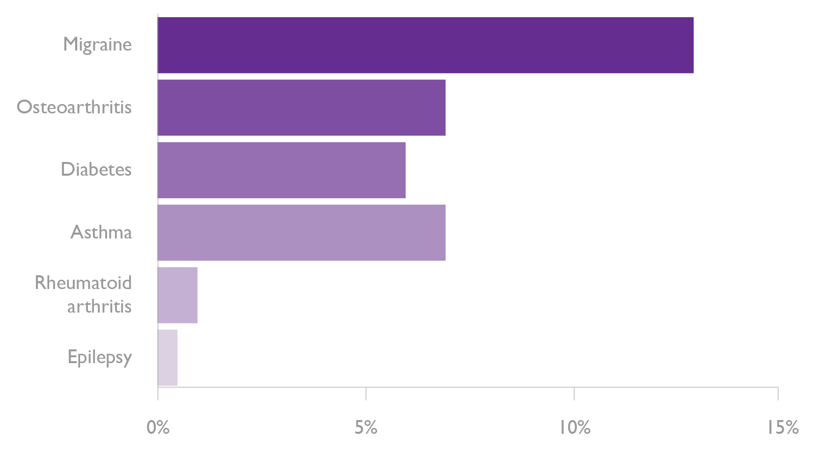
Migraine is common
In world-wide terms migraine…
Is the 3rd most common disease
Affects about 1 in 7 people
Is 3 times more common in women than men
According to US data, migraine is more common than diabetes, epilepsy and asthma combined
Refs: Steiner TJ et al. J Headache & Pain 2013, 14:1; World Health Organization. Atlas of headache disorders and resources in the world 2011.
Headache Disorders – not respected, not resourced. All-Party Parliamentary Group on Primary Headache Disorders. 2010;
www.cdc.gov/nedss; www.arthritis.org; www.census.gov; Hauser WA et al. Epilepsia 1993;34:453.
Notes:
Migraine is common
According to the World Health Organization, migraine is the most prevalent disabling neurological
disorder. Although prevalence rates vary, in European and North American studies, migraine was estimated to affect about 1 in 7 people. Probably in all regions, women are up to 3 times more likely to be affected than men.
In the latest report from the Global Burden of Disease Study, GBD 2015, migraine is among the top 10 causes (number 7) for years lived with disability.
References
World Health Organization. Headache Disorders and Public Health. Education and Management Implications. Available at http://www.migraines.org/new/newwho01.htm
GBD 2015 Disease and Injury Incidence and Prevalence Collaborators. Global, regional, and national incidence, prevalence, and years lived with disability for 310 diseases and injuries, 1990–2015: a systematic analysis for the Global Burden of Disease Study 2015. Lancet 2016;388:1545.

Slide 5
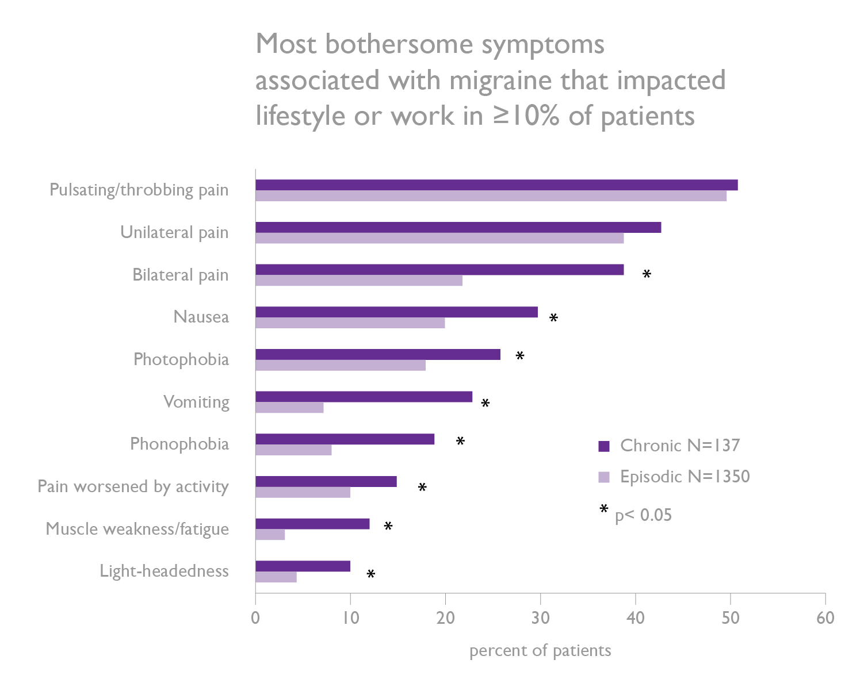
Migraine is disabling
Real-world data from the Adelphi Migraine US Disease Specific Program (2014) show that pain, nausea and photophobia were the key symptoms reported by patients as impacting their work and lifestyle
Ref: Ford J et al. EHMTIC 2016, Glasgow 15-18 September 2016. Abstract 173
Notes:
Migraine is disabling
Latest data from the Adelphi Migraine US Disease Specific Programme (2014) highlights this; pain, nausea and photophobia were key symptoms associated with migraine that significantly impacted patients’ lifestyle.
Reference
1. Ford J et al. EHMTIC 2016, Glasgow 15-18 September, 2016. Abstract 173

Slide 6
Migraine is disabling
Migraine attacks account for about 5% of an average person’s life; the percentage is substantially higher in those with severe chronic migraine
Depression is 3 times more common in people with migraine or severe headaches than in healthy individuals
In the USA, headache or pain in the head is the 4th leading cause of visits to the emergency department
Migraines/headaches account for 3.1% of all visits to emergency departments
3.1%
Refs: Steiner TJ et al. J Headache & Pain 2013, 14:1;
World Health Organization. Headache disorders. Fact sheet no.277, 2012;
Burch RC et al. Headache 2015;55:21.
Notes:
Migraine is disabling
Updated data from the US National Center for Health Statistics show that migraine is a leading cause of outpatient and emergency visits. Headache or pain in the head was the 4th leading cause of visits to the emergency department, accounting for 3.1% of all visits. In ambulatory care settings, more than half of all visits for migraine were in primary care.
Reference
Burch RC et al. The prevalence and burden of migraine and severe headache in the United States: updated statistics from government health surveillance studies. Headache 2015;55:21.

Slide 7
Migraine is costly
EuroLight Project
Cross-sectional survey in 8 countries (55% of EU adult population)
Mean per-person annual costs were €1222
Total annual cost of migraine in EU: €111 billion
In the UK
25 million days are lost from work or school each year because of migraine, costing £2.25 billion
The cost to the NHS is £150 million per year
Despite its economic impact, migraine is the least publicly funded of all neurological illnesses
Refs: Linde M et al. Eur J Neurol 2012;19:703; Steiner TJ et al. Cephalalgia 2003;23:519;
Headache Disorders – not respected, not resourced. All-Party Parliamentary Group on Primary Headache Disorders. 2010;
Shapiro RE & Goadsby PJ. Cephalalgia 2007;27:991-4.
Notes:
Migraine is costly
Studies in Europe have highlighted the cost of migraine to healthcare budgets.
Based on estimates from the EuroLight Project, a cross-sectional survey in 8 European countries (55% of the EU adult population), the total annual cost of migraine in the EU was €111 billion. In the UK, the cost of migraine to the National Health Service has been estimated at £150 million per year.
Yet while migraine is a key driver of economic loss to healthcare budgets, funding for management and research is among the least of all neurological disorders.
References
Linde M et al. The cost of headache disorders in Europe: the Eurolight project. Eur J Neurol 2012;19:703.
Shapiro RE, Goadsby PJ. The long drought: the dearth of public funding for headache research. Cephalalgia 2007;27:991-4

Slide 8
ISSUES WITH CURRENT MANAGEMENT

Slide 9
Migraine is underdiagnosed
World-wide, 60% of individuals with migraine are not professionally diagnosed
Less than 50% of patients consult a clinician
There is a lack of professional training:
~ 4 hours are allocated to undergraduate training
~ 10 hours are allocated for specialist training
Ref:WHO Atlas of headache disorders and resources in the world 2011; Pavone E et al. Cephalalgia. 2007;27:1000-4;
Diamond S et al. Headache 2007;47:355.
Notes:
Migraine is underdiagnosed
Data from the American Migraine Prevalence and Prevention study highlight the extent of the problem. In a survey of 162,576 subjects, only slightly more than half of those reporting migraine (56%) had ever received a medical diagnosis.
Reference
Diamond S et al. Patterns of diagnosis and acute and preventive treatment for migraine in the United States: results from the American Migraine Prevalence and Prevention study. Headache 2007;47:355.

Slide 10
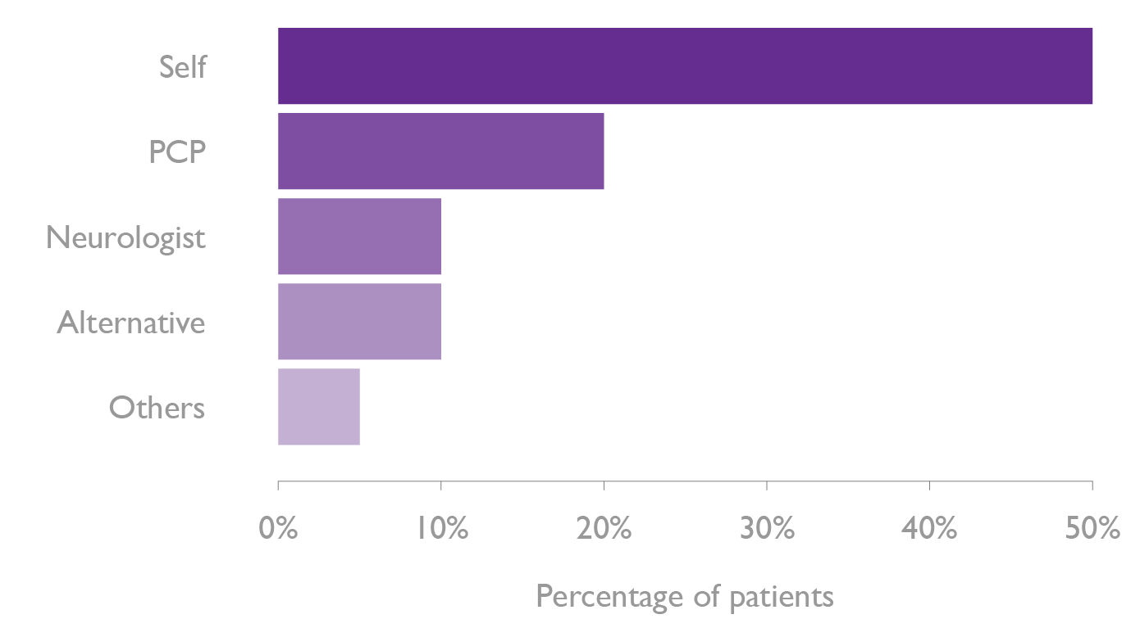
Migraine is undertreated
World-wide, about 50% of people with migraine are self-medicating
In the AMPP study of migraine treatment:
49% used OTC medication only
29% used prescription and OTC medication
Only 1 in 8 received preventive therapy
Prescription of migraine medication
Ref: WHO Atlas of headache disorders and resources in the world 2011; Diamond S et al. Headache 2007;47:355
Notes:
Migraine is undertreated
In the American Migraine Prevalence and Prevention study (n=162,576), 98% with migraine reported the use of acute treatments, which was over the counter medications for half. Only 1 in 8 received preventive migraine medications, mostly prescribed by the primary care physician.
Reference
Diamond S et al. Patterns of diagnosis and acute and preventive treatment for migraine in the United States: results from the American Migraine Prevalence and Prevention study. Headache 2007;47:355.

Slide 11
The aims of treatment
Acute | Preventive
Goal: complete pain relief/improvement after 2 hours | Goal: to reduce the frequency and severity of attacks by at least 50%
Relief of associated symptoms | Reduce duration of attacks
Restoration of normal functioning | Improve responsiveness to acute therapy
Prevention of recurrence | Prevent medication overuse headache
Consistent efficacy in 2-3 attacks | Improve function and reduce disability
Sustained pain relief within 24 hours
Ref: Giamberardino MA & Martelletti P. Expert Opin Emerg Drugs 2015;20:137

Slide 12
Multiple guidelines for migraine management exist
Year of publication | Guideline
2012 | American Headache Society and American Academy of Neurology
2012 | Canadian Headache Society
2012 | Danish Headache Society
2012 | BASH
 | NICE
 | SIGN
Refs: Silberstein SD et al. Neurology 2012;78:1337; Canadian Headache Society Prophylactic Guidelines Development Group. Can J Neurol Sci 2012; 39(2 Suppl 2):S1; Bendtsen L et al. J Headache Pain 2012;13 Suppl 1:S1; NICE Clinical Guideline 150; SIGN Quick reference guide 107

Slide 13
Multiple guidelines for migraine management exist
Discordance in some areas:
Methodology for appraisal and classification
Inconsistent appraisal of risk-benefit profile for treatment options
Need for uniform, consistent up-to-date guidelines endorsed by all
BUT…

Slide 14
Limitations of current preventive therapies
Most treatments come from other therapeutic areas
There are safety and tolerability issues
Efficacy is modest, requiring frequent administration
Co-morbidities (e.g. hypertension and depression) can restrict therapeutic options
Ref: Evers S et al. Eur J Neurol 2009;16:968; Blumenfeld AM et al. Headache 2013;53:644; Berger A et al. Pain Pract 2012;12:541; Buse DC et al. Neurol Neurosurg Psychiatry 2010;31:428.

Slide 15
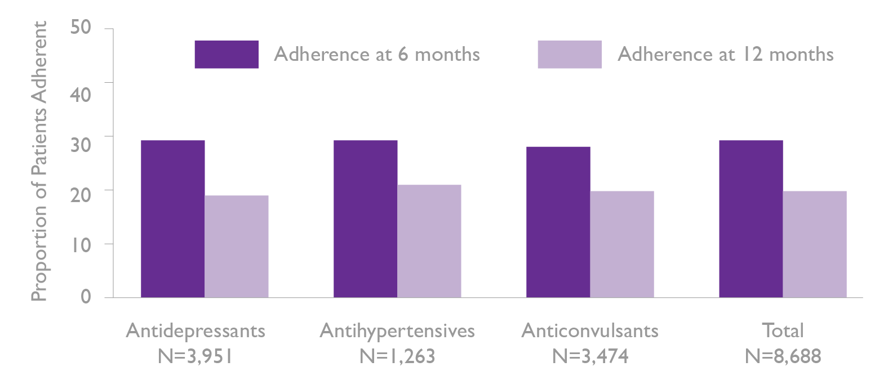
Low adherence with current preventive therapy
Retrospective claims analysis of a US claim database for 8,688 chronic migraine patients
Regardless of medication used, adherence was low among oral migraine-preventive medications
Ref: Hepp Z et al. Cephalalgia 2015;35:478
Notes:
Low adherence with current preventive therapy
Retrospective claims analysis of a US claim database (Truven MarketScan® Databases) was used to identify patients ≥18 years with chronic migraine who initiated an oral migraine-preventive medication (antidepressants, beta blockers, or anticonvulsants) between January 1, 2008 and September 30, 2012. In total, 8,688 subjects with chronic migraine met the study criteria.
Regardless of medication type, adherence was low at 6 months (26-29%) and had worsened by 12 months (17-20%).
Reference
Hepp Z et al. Adherence to oral migraine-preventive medications among patients with chronic migraine. Cephalalgia 2015;35:478.

Slide 16
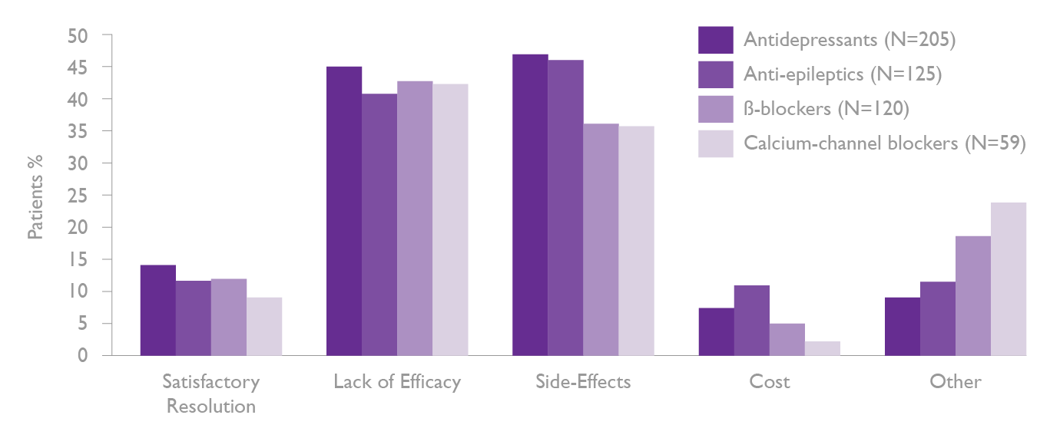
Reasons for poor adherence
Side-effects and lack of efficacy are the key drivers of suboptimal adherence
Reasons reported by patients for discontinuation of preventive medication
Ref: Blumenfeld AM et al. Headache 2013;53:644
Notes:
Reasons for poor adherence
The second international burden of migraine study (IBMS-II) investigated patterns of preventive medication use in a survey of 1,165 individuals with episodic migraine (EM) and chronic migraine (CM). Only 28% of those with EM and 45% of those with CM were currently using preventive medication. Side effects with treatment and lack of efficacy were the two key drivers of treatment discontinuation across all types of medication used.
References
Blumenfeld AM et al. Patterns of use and reasons for discontinuation of prophylactic medications for episodic migraine and chronic migraine: results from the second international burden of migraine study (IBMS-II). Headache 2013;53:644.

Slide 17
The unmet needs in migraine
Underdiagnosis and undertreatment
Lack of concordance between guidelines
Issues with available preventive strategies, specifically efficacy and tolerability
Long-term adherence can be problematic
Co-morbidities can restrict treatment choice

